Slide 1




Whole-Genome sequencing technologies

Slide 2
Learning objectives
Understand the principles behind the different sequencing technologies
Library preparation methods and their effect on the data
Perform quality control (QC) on long-read sequencing data
Align long-reads to a reference genome
Call SNPs in long-read sequencing data
Analyze differences between sequencing technologies
Compare and intersect VCF files
Use common benchmarking metrics

Slide 3
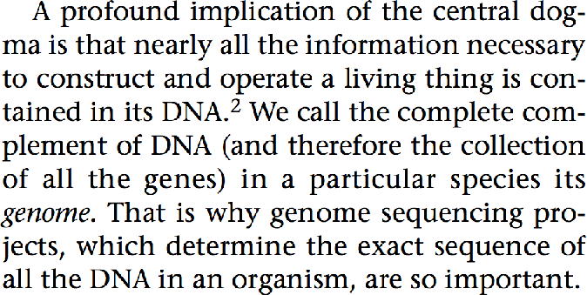
Why is DNA sequencing important
Hunter, Lawrence. "Life and its molecules: A brief introduction." AI Magazine 25.1 (2004): 9.

Slide 4
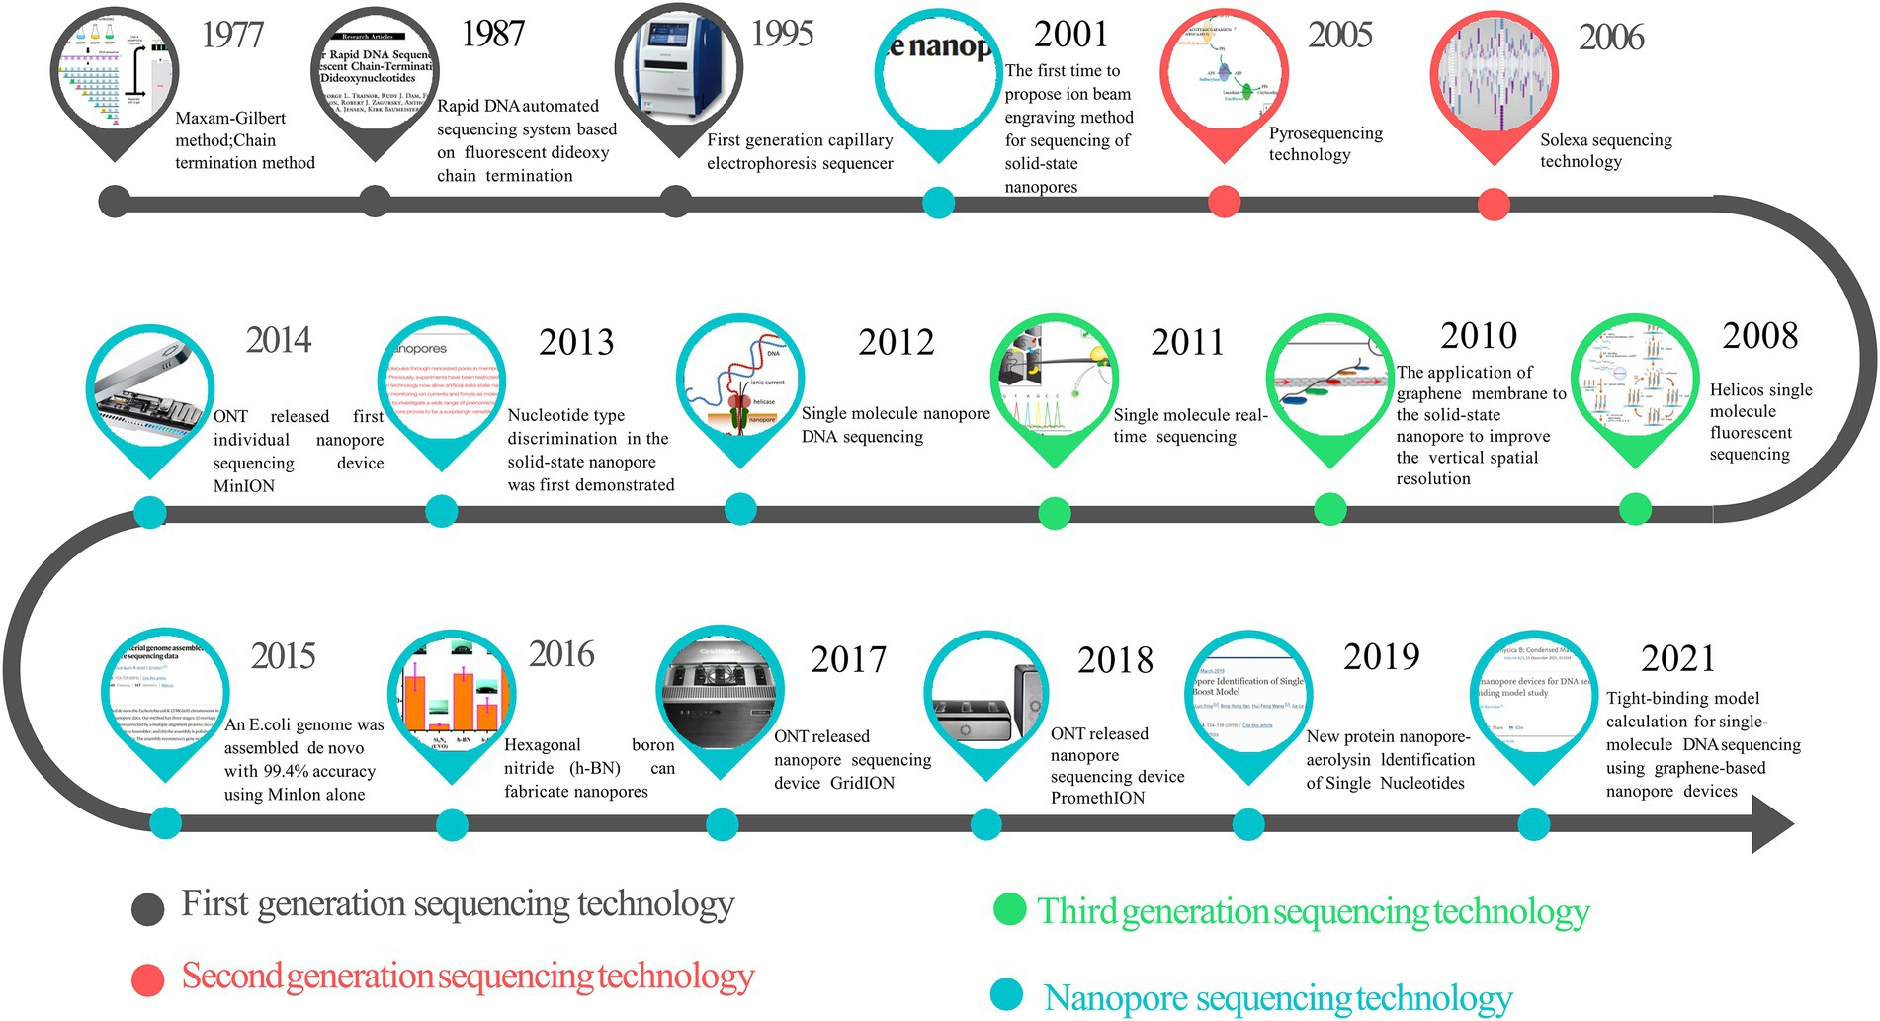
History of genome sequencing
1977 DNA Sequencing by Chemical Degradation” by Allan Maxam and Walter Gilbert
1978 DNA Sequencing by Enzymatic Synthesis” is published by Fred Sanger
1980 Fred Sanger and Walter Gilbert receive the Nobel Prize in Chemistry
1982 GenBank starts as a public repository of DNA sequences
1986 Leroy Hood’s laboratory at the California Institute of Technology announces the first semi-automated DNA sequencing machine.
1977 Genome sequence of E. coli is published
2001 Draft sequence of the Human genome is published
2004 First next generation sequencing technologies become available
2009 Genome-wide single-cell sequencing becomes available

Slide 5
Genomics technology
First-Generation Sequencing
Low throughput
Radio- or fluorescently-labelled dNTPs or oligonucleotides before electrophoretic analysis
Eg: Sanger sequencing
Second-Generation Sequencing
High throughput
Parallelization of a large number of reactions
Eg: Illumina.
Third-Generation Sequencing
Sequencing single molecules, so they don't require DNA amplification.
PacBio (Pacific Biosciences) and ONT (Oxford Nanopore).
Fourth-Generation Sequencing?
Spatial Genomics (eg: 10x Genomics, NanoString, Bio-Rad…)

Slide 6
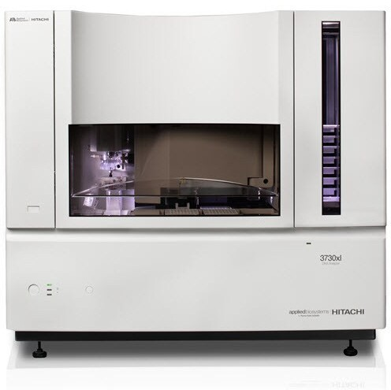
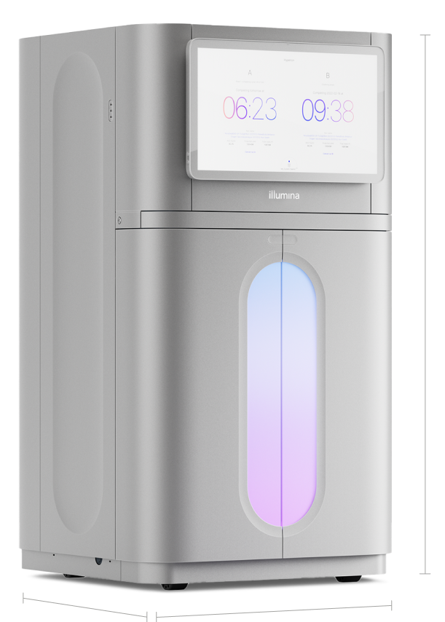

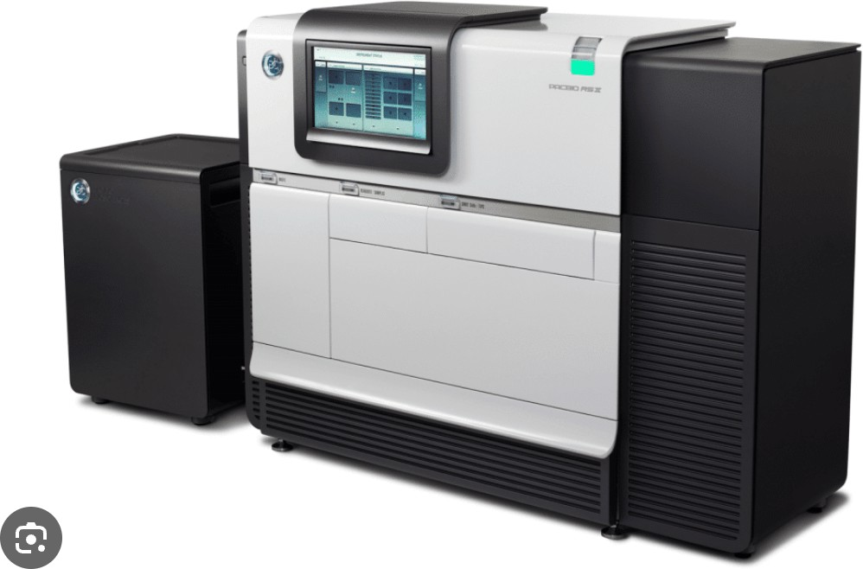
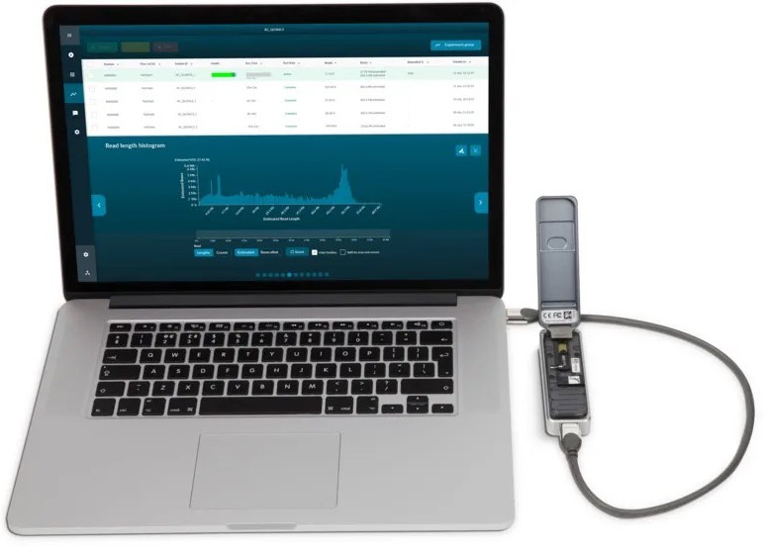
Genomics technology
1st era
2nd era
3rd era
4th era
Sanger sequencing, Genome Projects
Short reads
Early Long Reads
Telomere-to-telomere

Slide 7
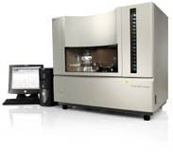

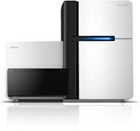


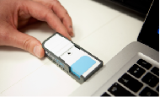


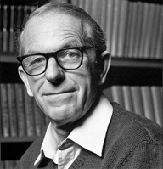
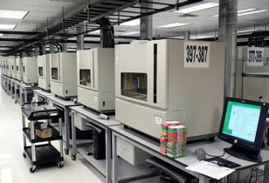
Genomics technology
Sanger DNA sequencing
1977-1990s
3rd-generation & single-molecule DNA sequencing
Since ~2010
DNA Microarrays
2nd-generation DNA sequencing
Since ~2007
Since mid-1990s
Fred Sanger 1918-2013
“Chain termination”
sequencing

Slide 8
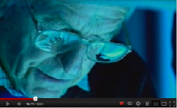
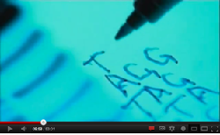
Sanger sequencing
Sanger sequencing 1977-1990s
Fred Sanger in episode 3 of PBS documentary “DNA”
Not-so-high-throughput Sanger sequencing
First practical method invented by Fred Sanger in 1977. Initially used to sequence shorter genomes,
e.g. viral genomes 10,000s of bases long.

Slide 9
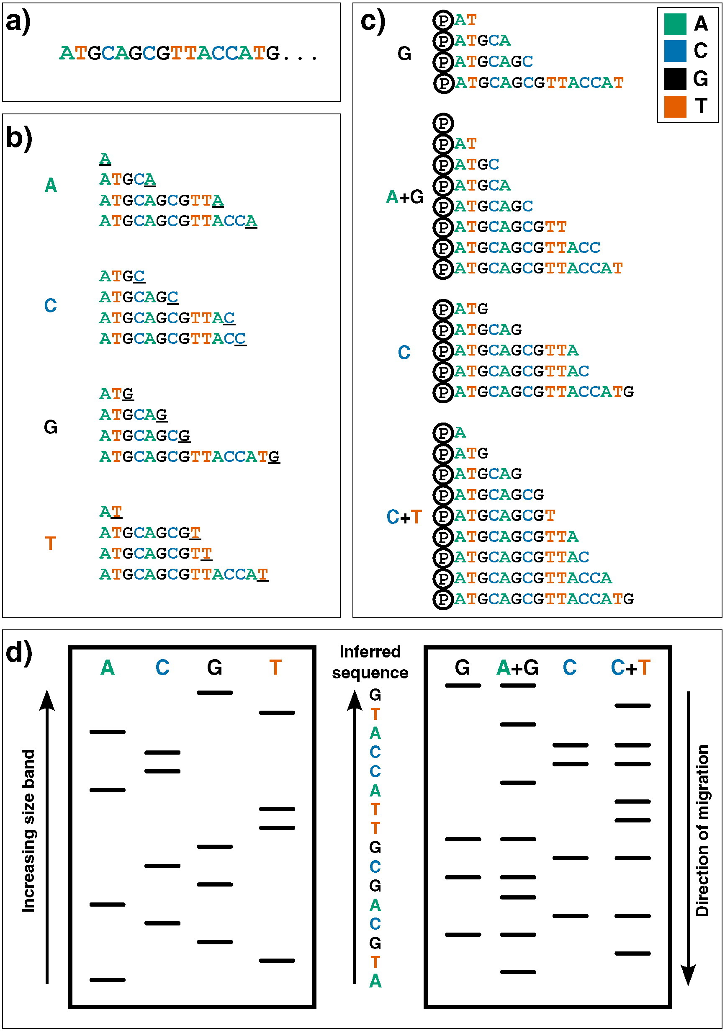
Sanger sequencing
DNA template
Primer
Flourescent Dideoxy nucleotides (ddNTPs) – No hydroxyl group
A C G T
Normal nucleotides
A C G T

Slide 10
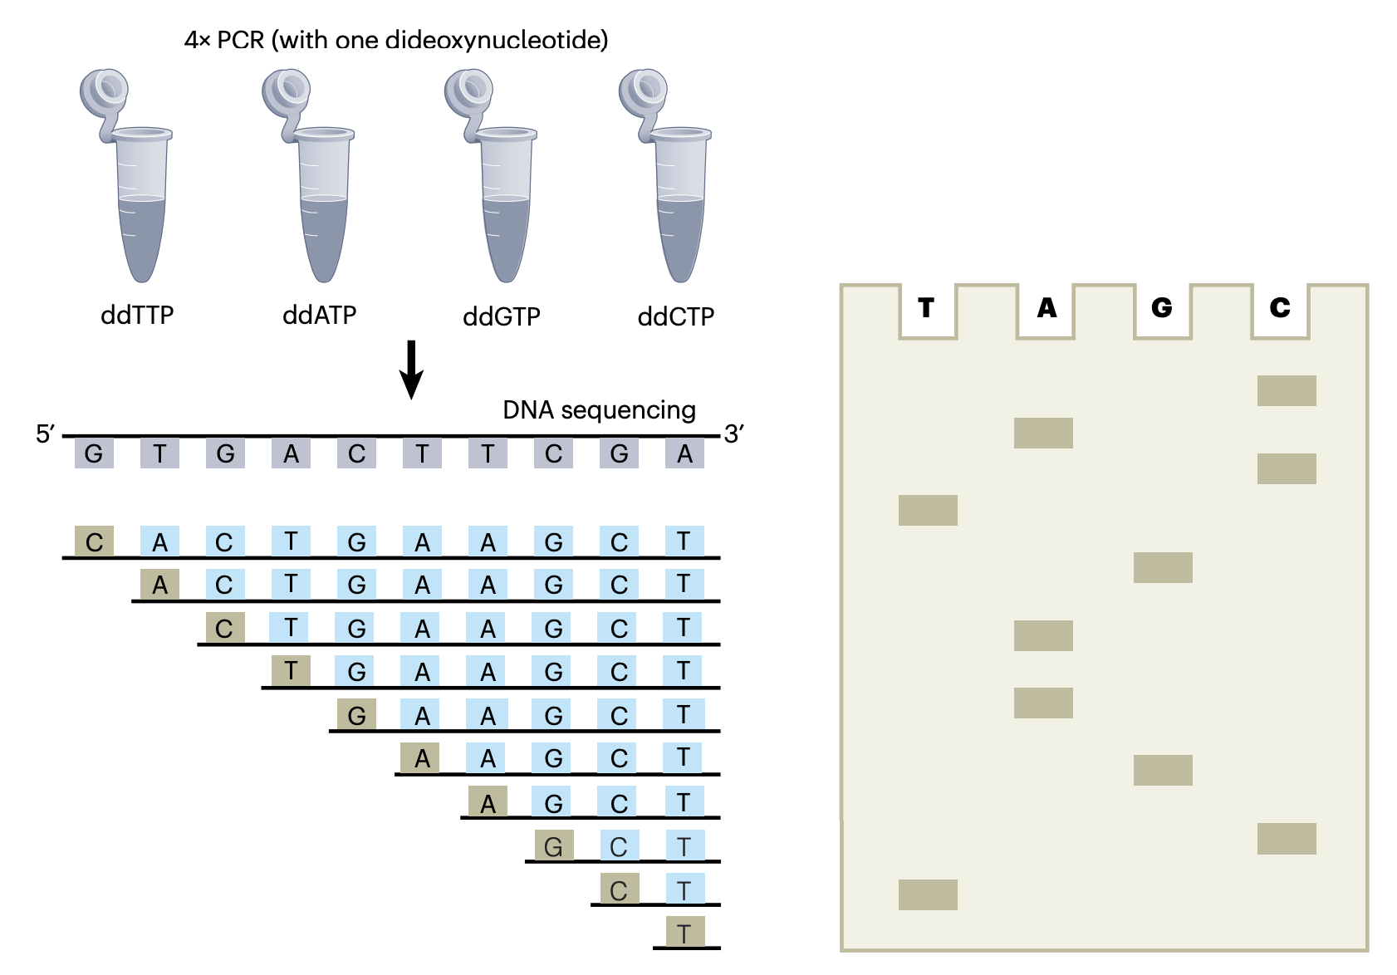
Sanger sequencing
https://www.nature.com/articles/s41587-023-01986-3

Slide 11
Sanger sequencing
A
C
G
T

Slide 12
Sanger sequencing
A
C
G
T

Slide 13
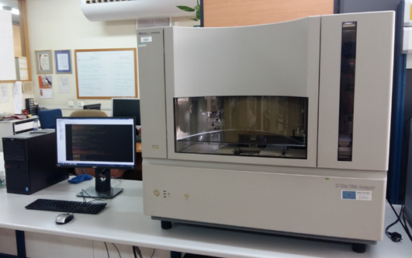
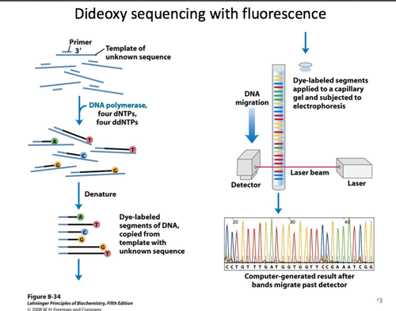
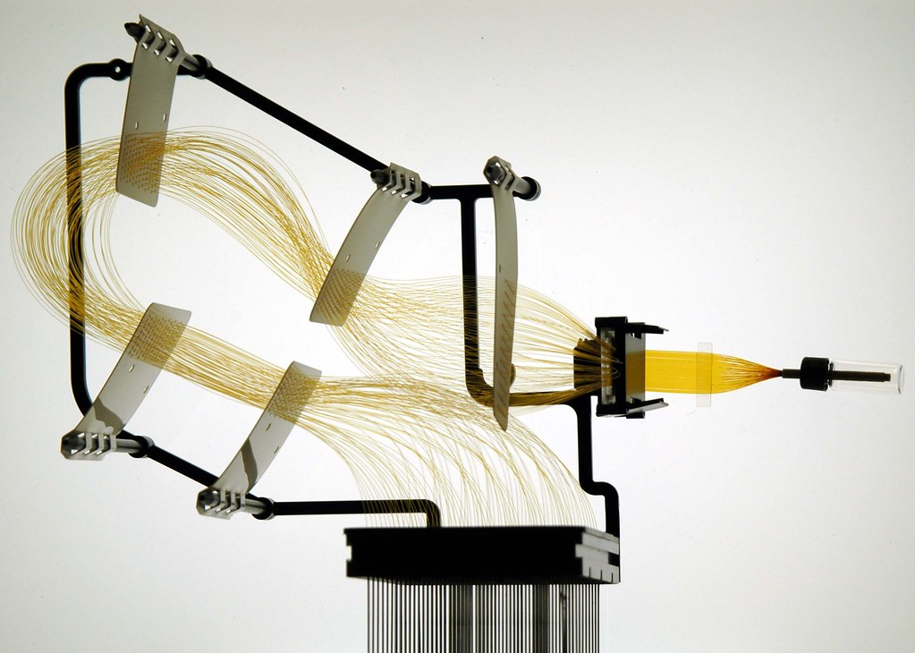
Sanger sequencing

Slide 14
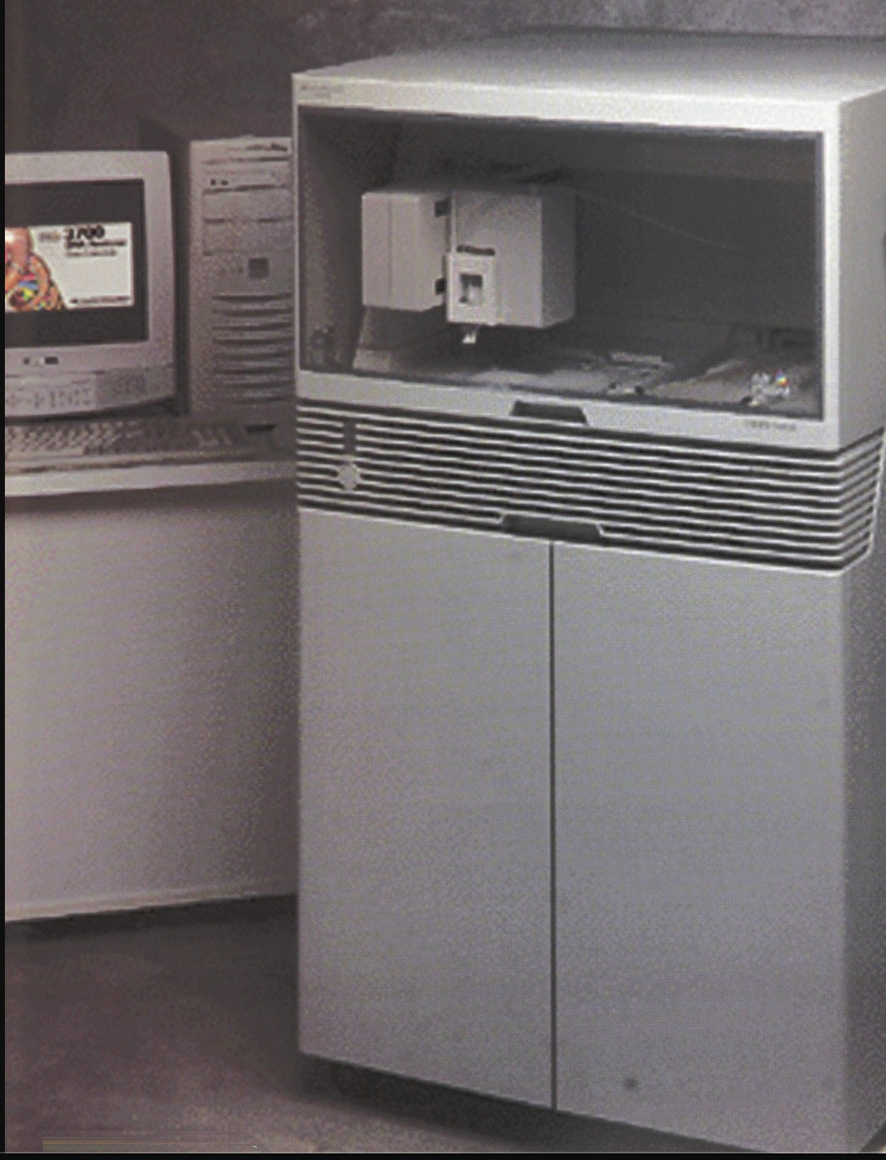
Sanger sequencing throughput
1977: Sanger et al invents method
700 bases per day
= 12,000 years to sequence the human genome
1985: ABI 370
(first automated sequencer)
5000 bases per day
= 1,600 years
1995: ABI 377
(Bigger gels, better chemistry & optics, more sensitive dyes, faster computers)
19,000 bases per day
= 430 years
1999: ABI 3700 (96
capillaries, 96 well plates, fluid handling robots)
7
400,000 bases per day
= 20.5 years
https://journals.sagepub.com/cms/10.1177/221106829800300503/asset/images/large/10.1177_221106829800300503-fig2.jpeg
7

Slide 15


Genomics technology
2nd-generation DNA sequencing
Since ~2007
Sanger DNA sequencing
1977-1990s
3rd-generation & single-molecule DNA sequencing
Since ~2010
DNA Microarrays
Since mid-1990s

Slide 16
Second Generation Sequencing
Common components
Flow cells as reaction chambers
Iterative sequencing process
Massive parallelization
Clonally amplified or single molecule templates
Differences
Template preparation
Sequencing chemistry
Flow cell configuration

Slide 17
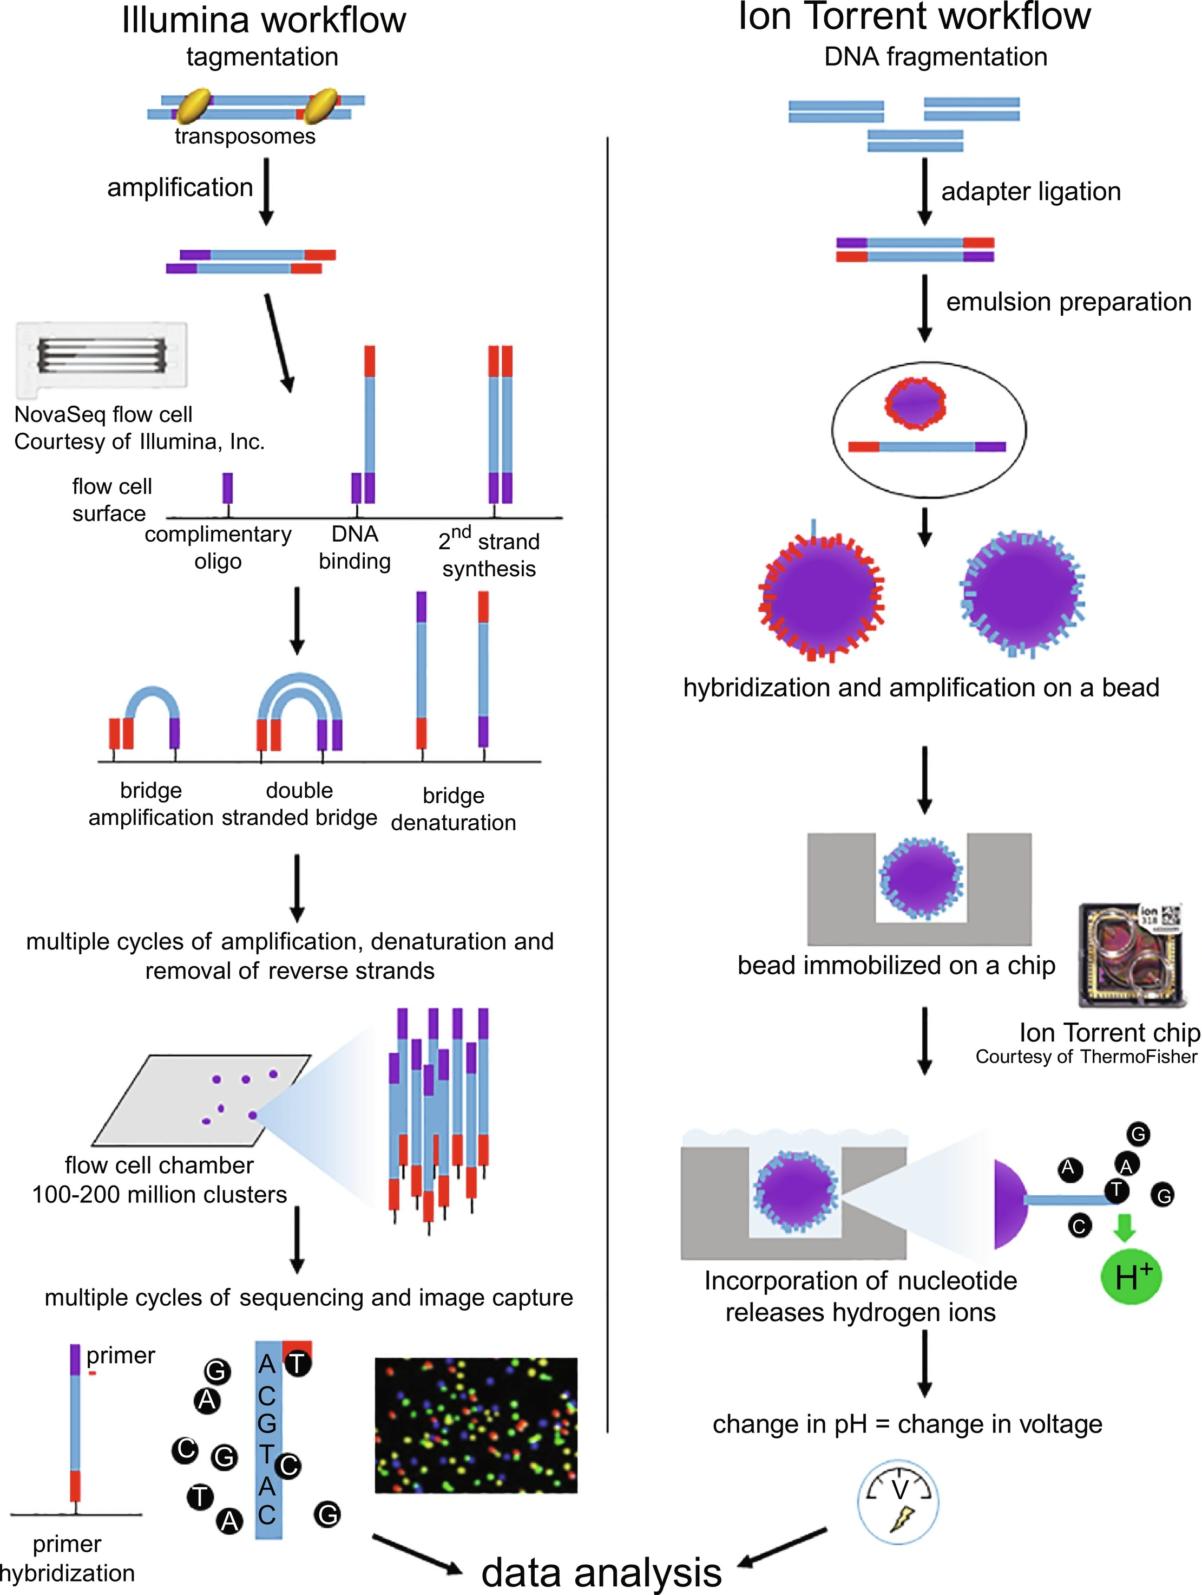
Illumina – Sequencing by synthesis

Slide 18
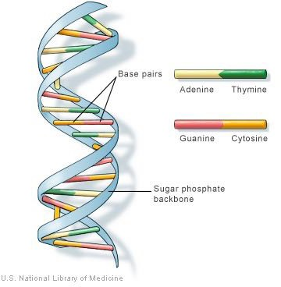
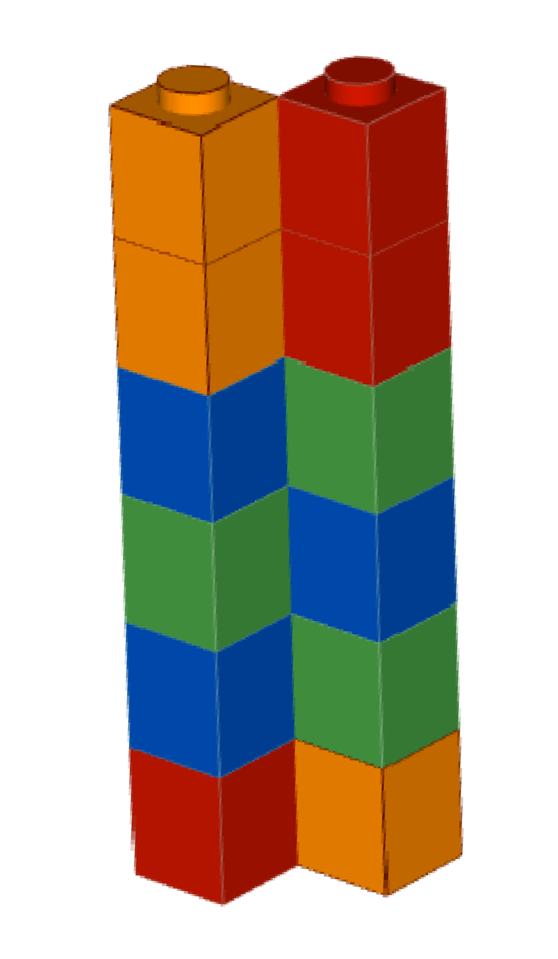
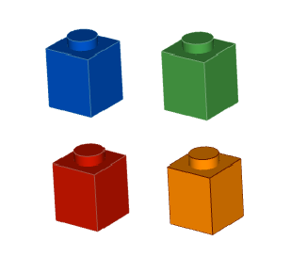
Illumina – Sequencing by synthesis
A
T
G
C
Double stranded DNA (double helix)
Double stranded DNA (lego version)

Slide 19
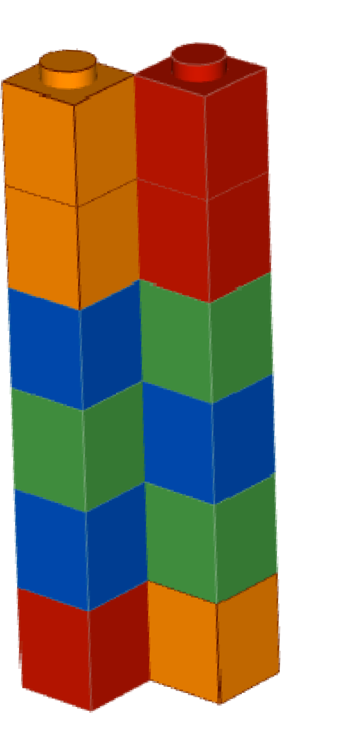
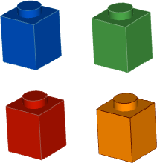
Illumina – Sequencing by synthesis
C C A T A G
G G T A T C
A
T
G
C

Slide 20
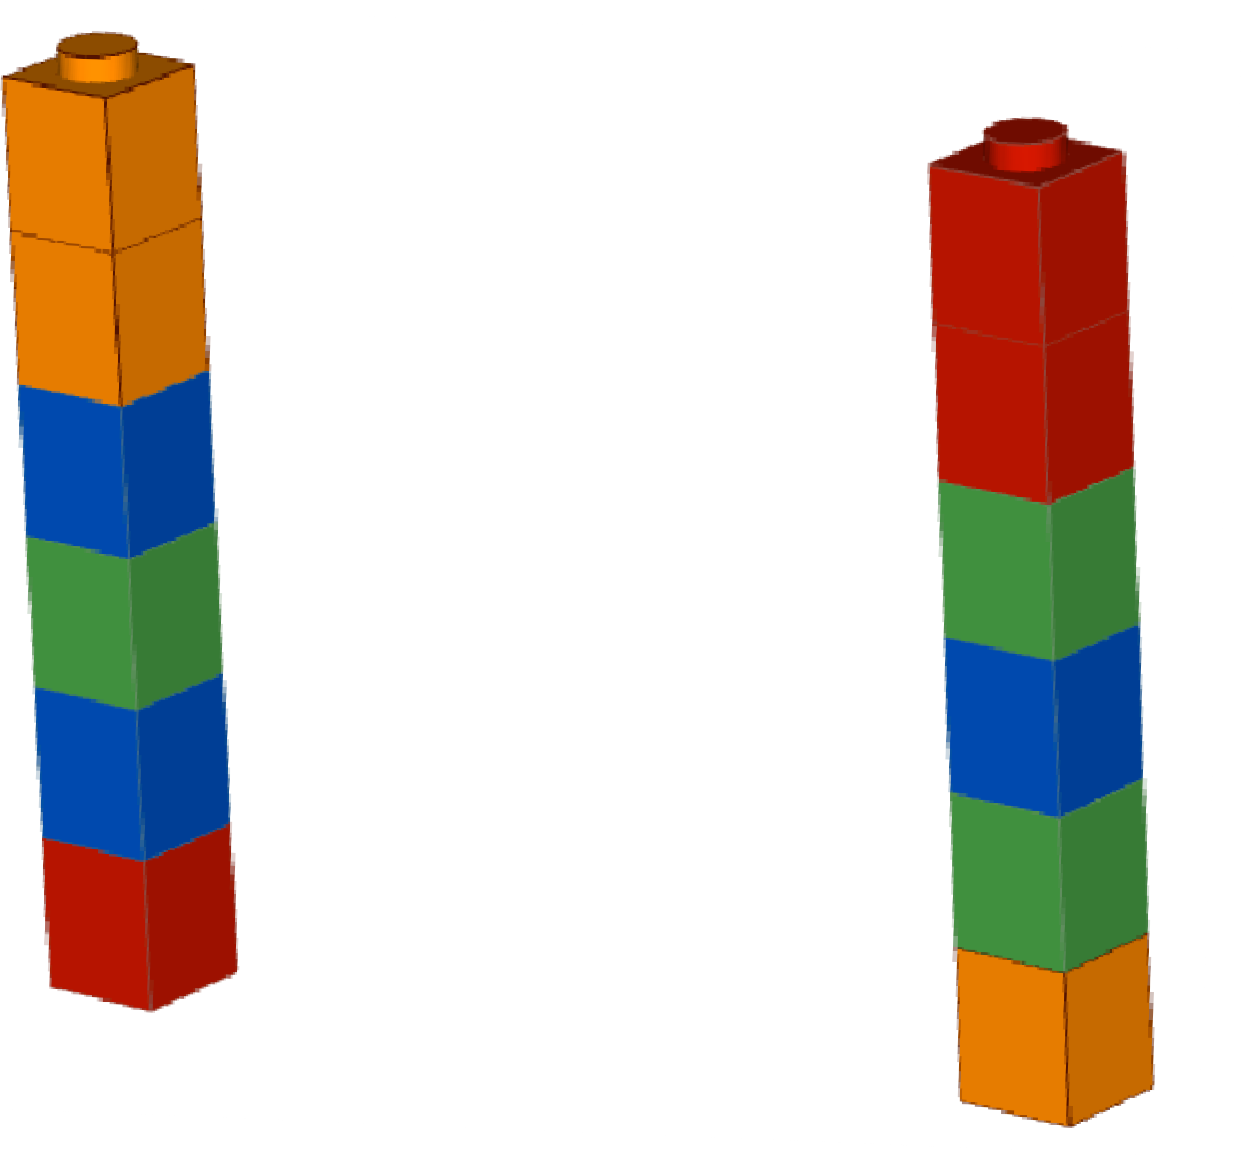
Illumina – Sequencing by synthesis
C C A T A G
G G T A T C
Single stranded templates

Slide 21
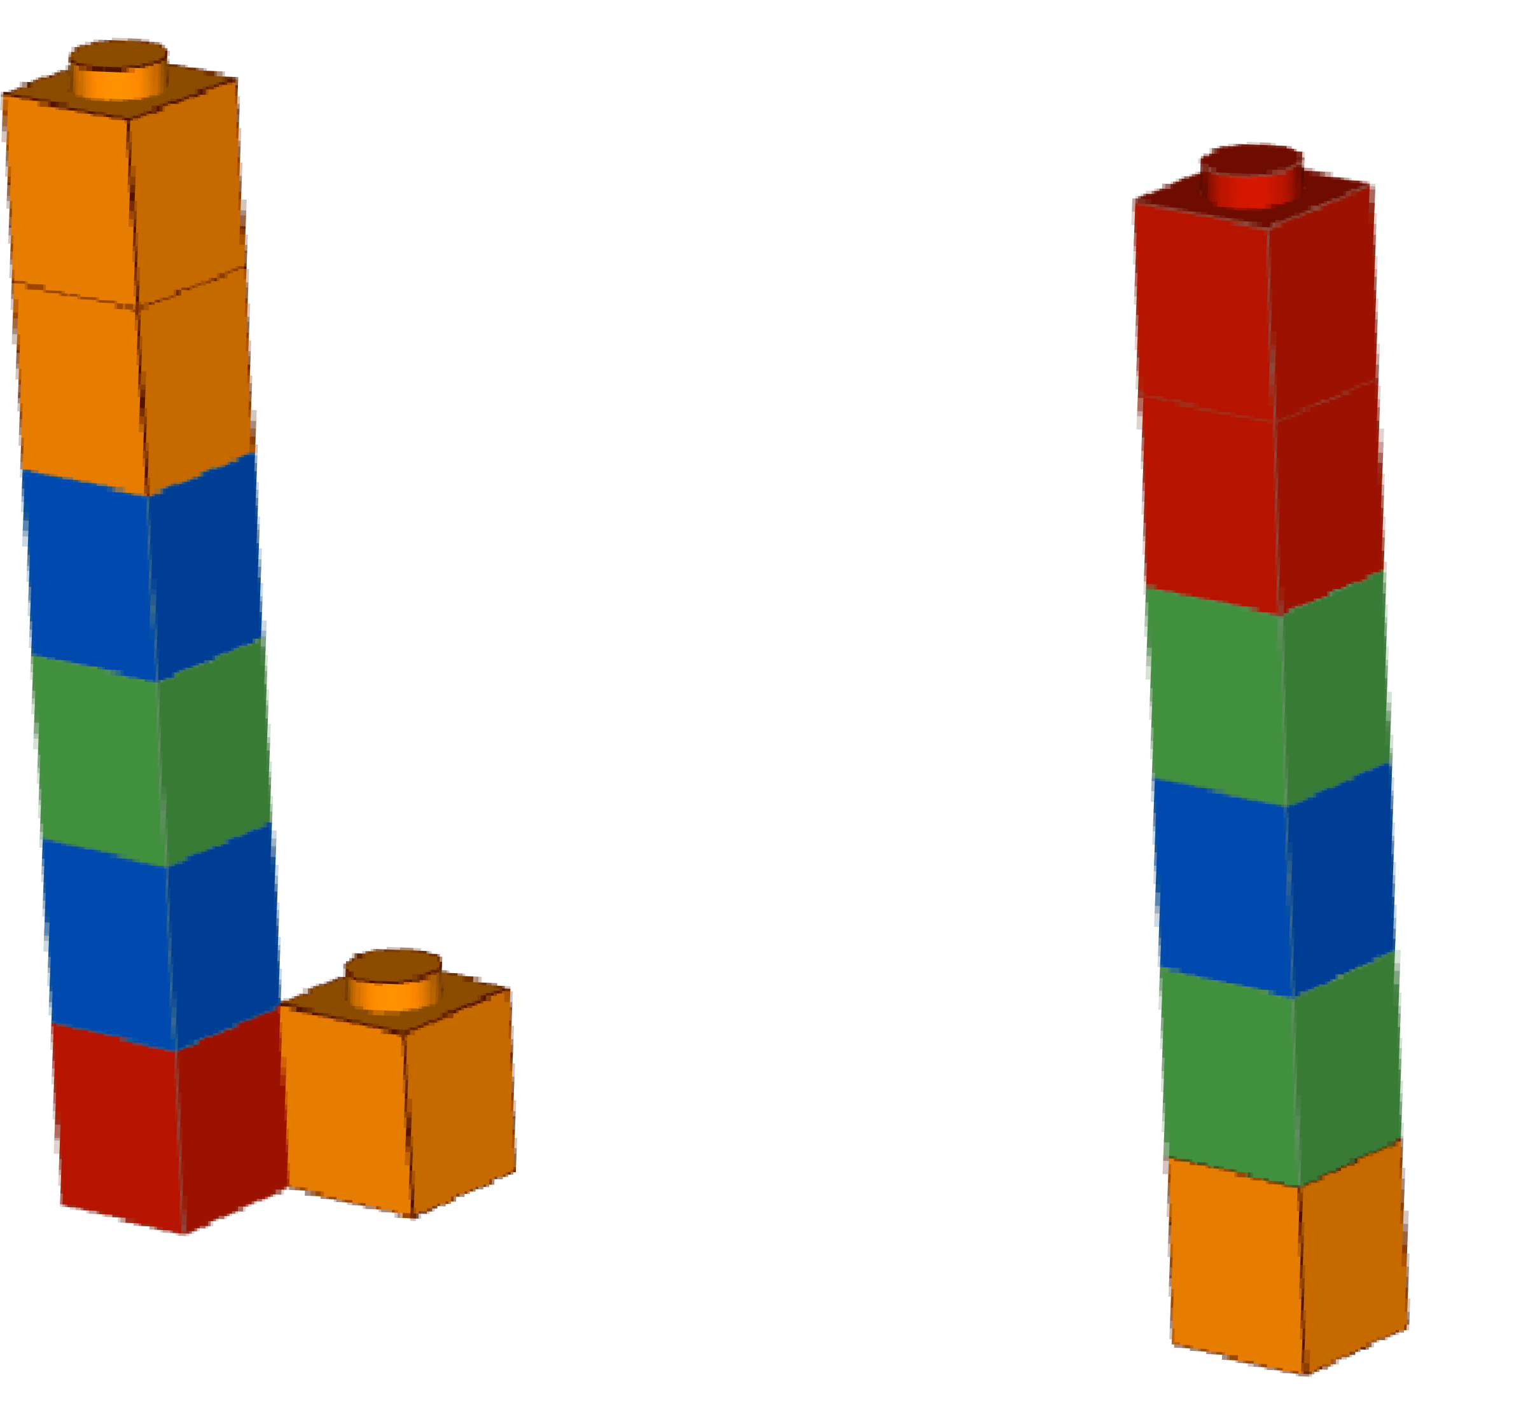
Illumina – Sequencing by synthesis
C C A T A G
G G T A T C
C

Slide 22

Illumina – Sequencing by synthesis
C C A T A G
G G
T A T C
DNA polymerase
C

Slide 23
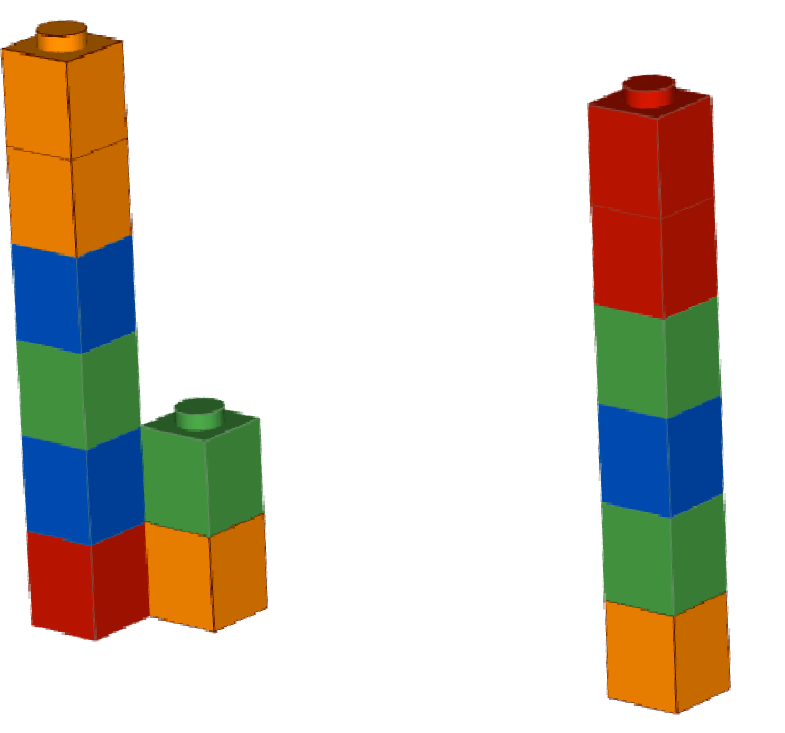
Illumina – Sequencing by synthesis
C C A T A G
G G T A T C
T C

Slide 24
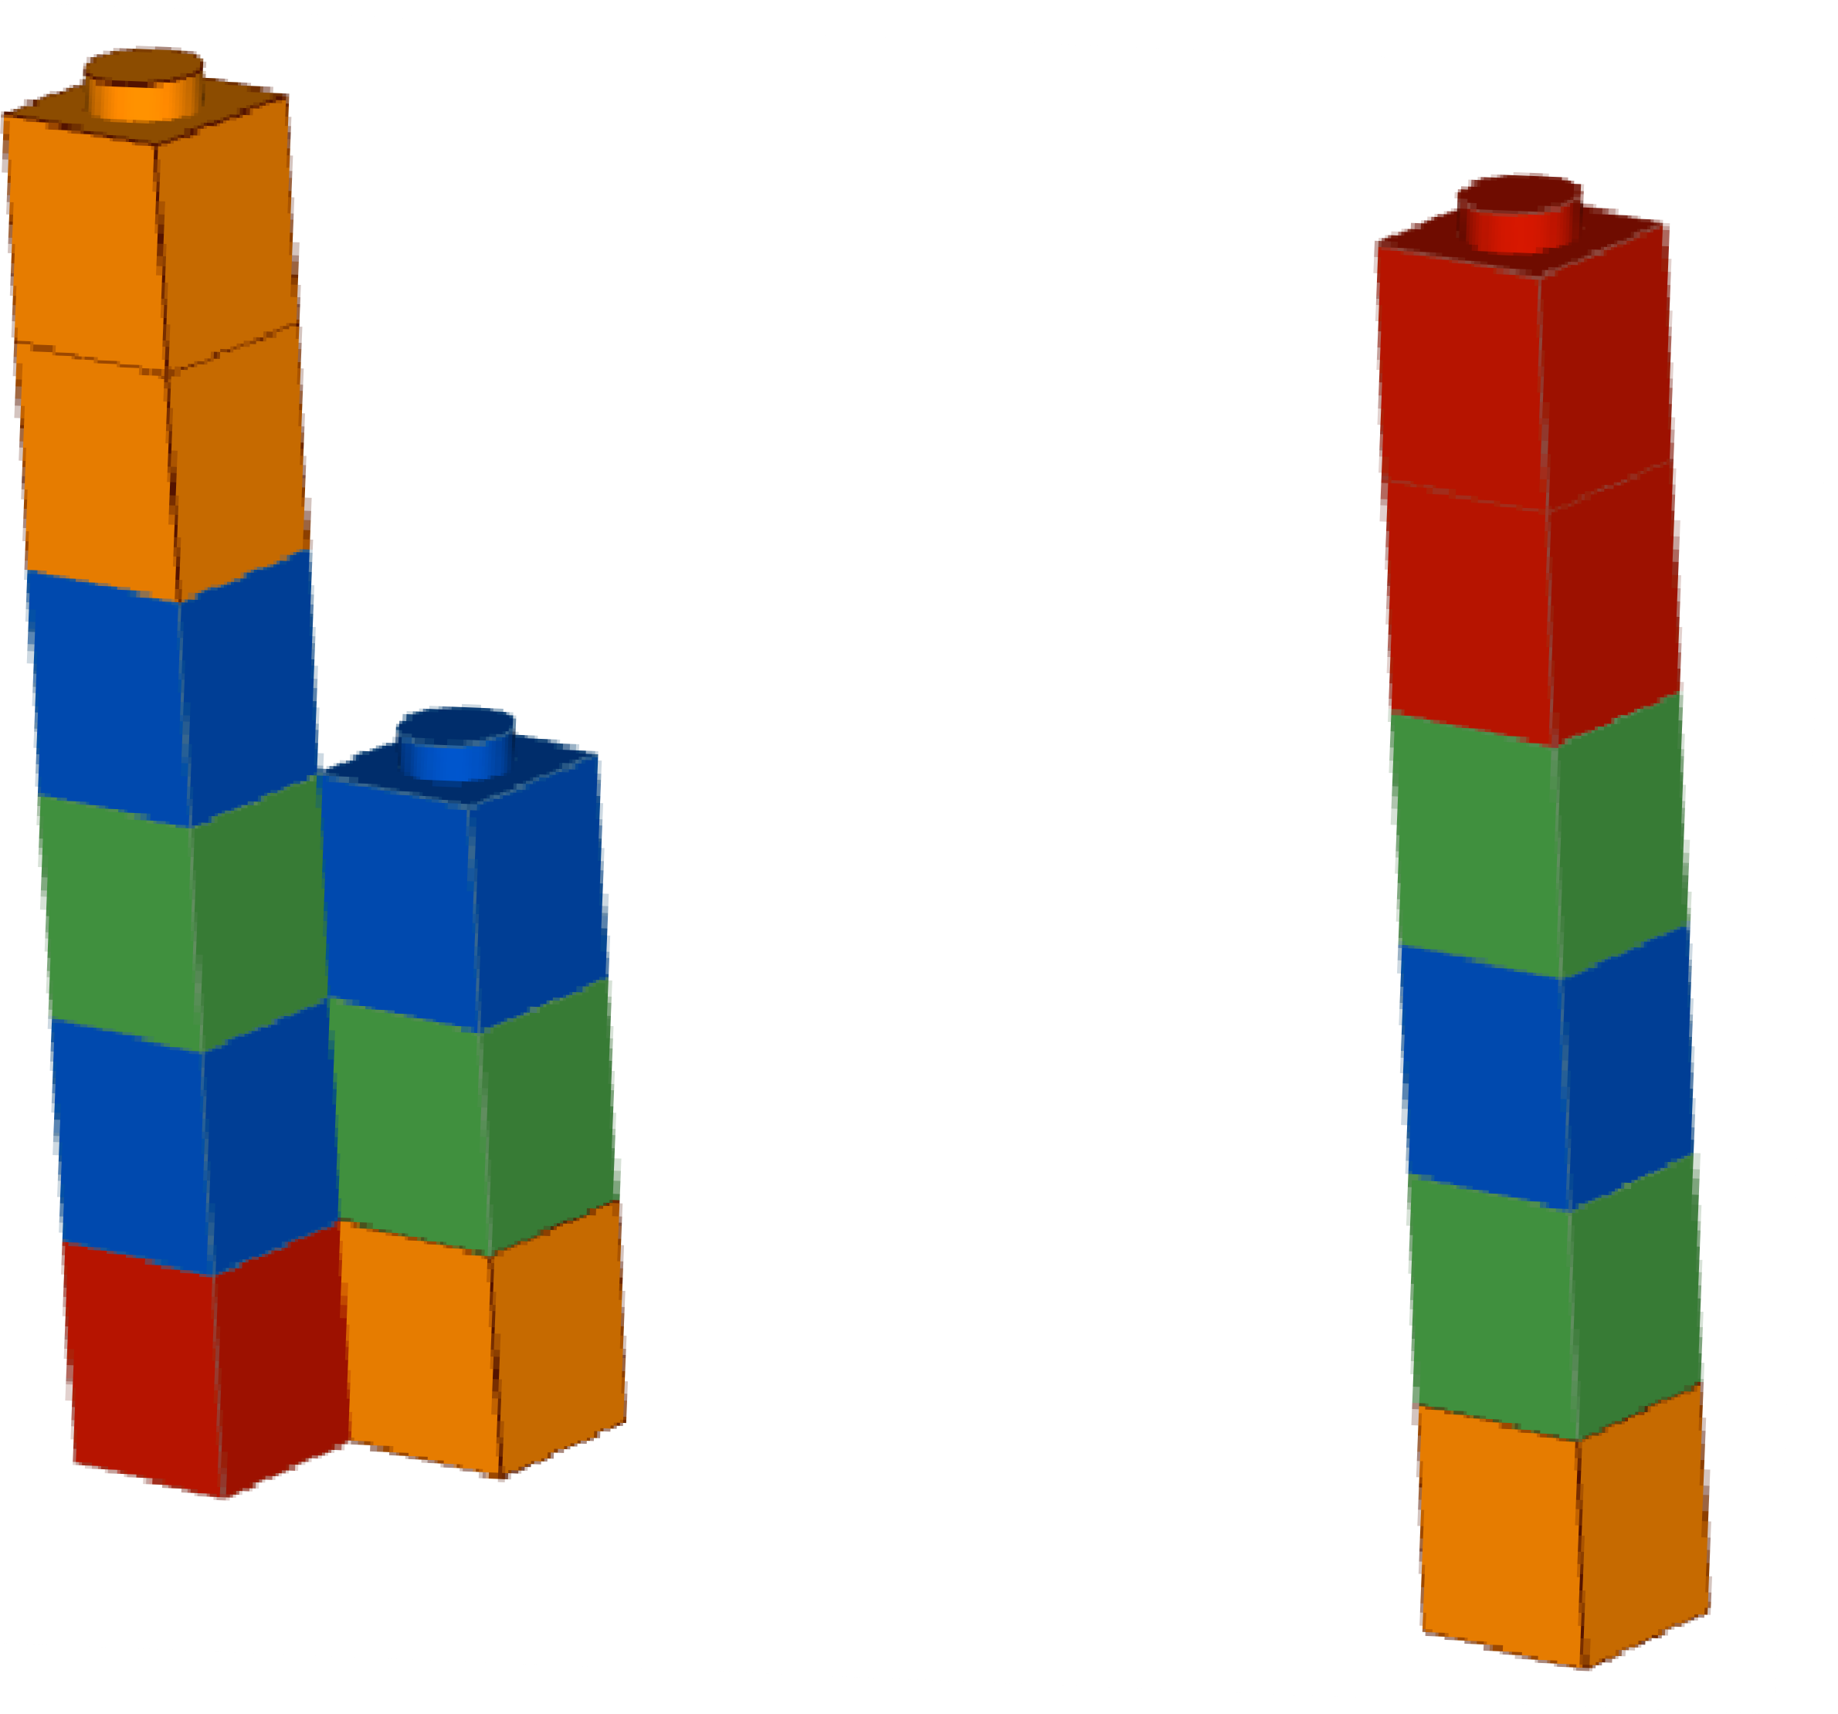
Illumina – Sequencing by synthesis
C C A T A G
G G T A T C
A T C

Slide 25
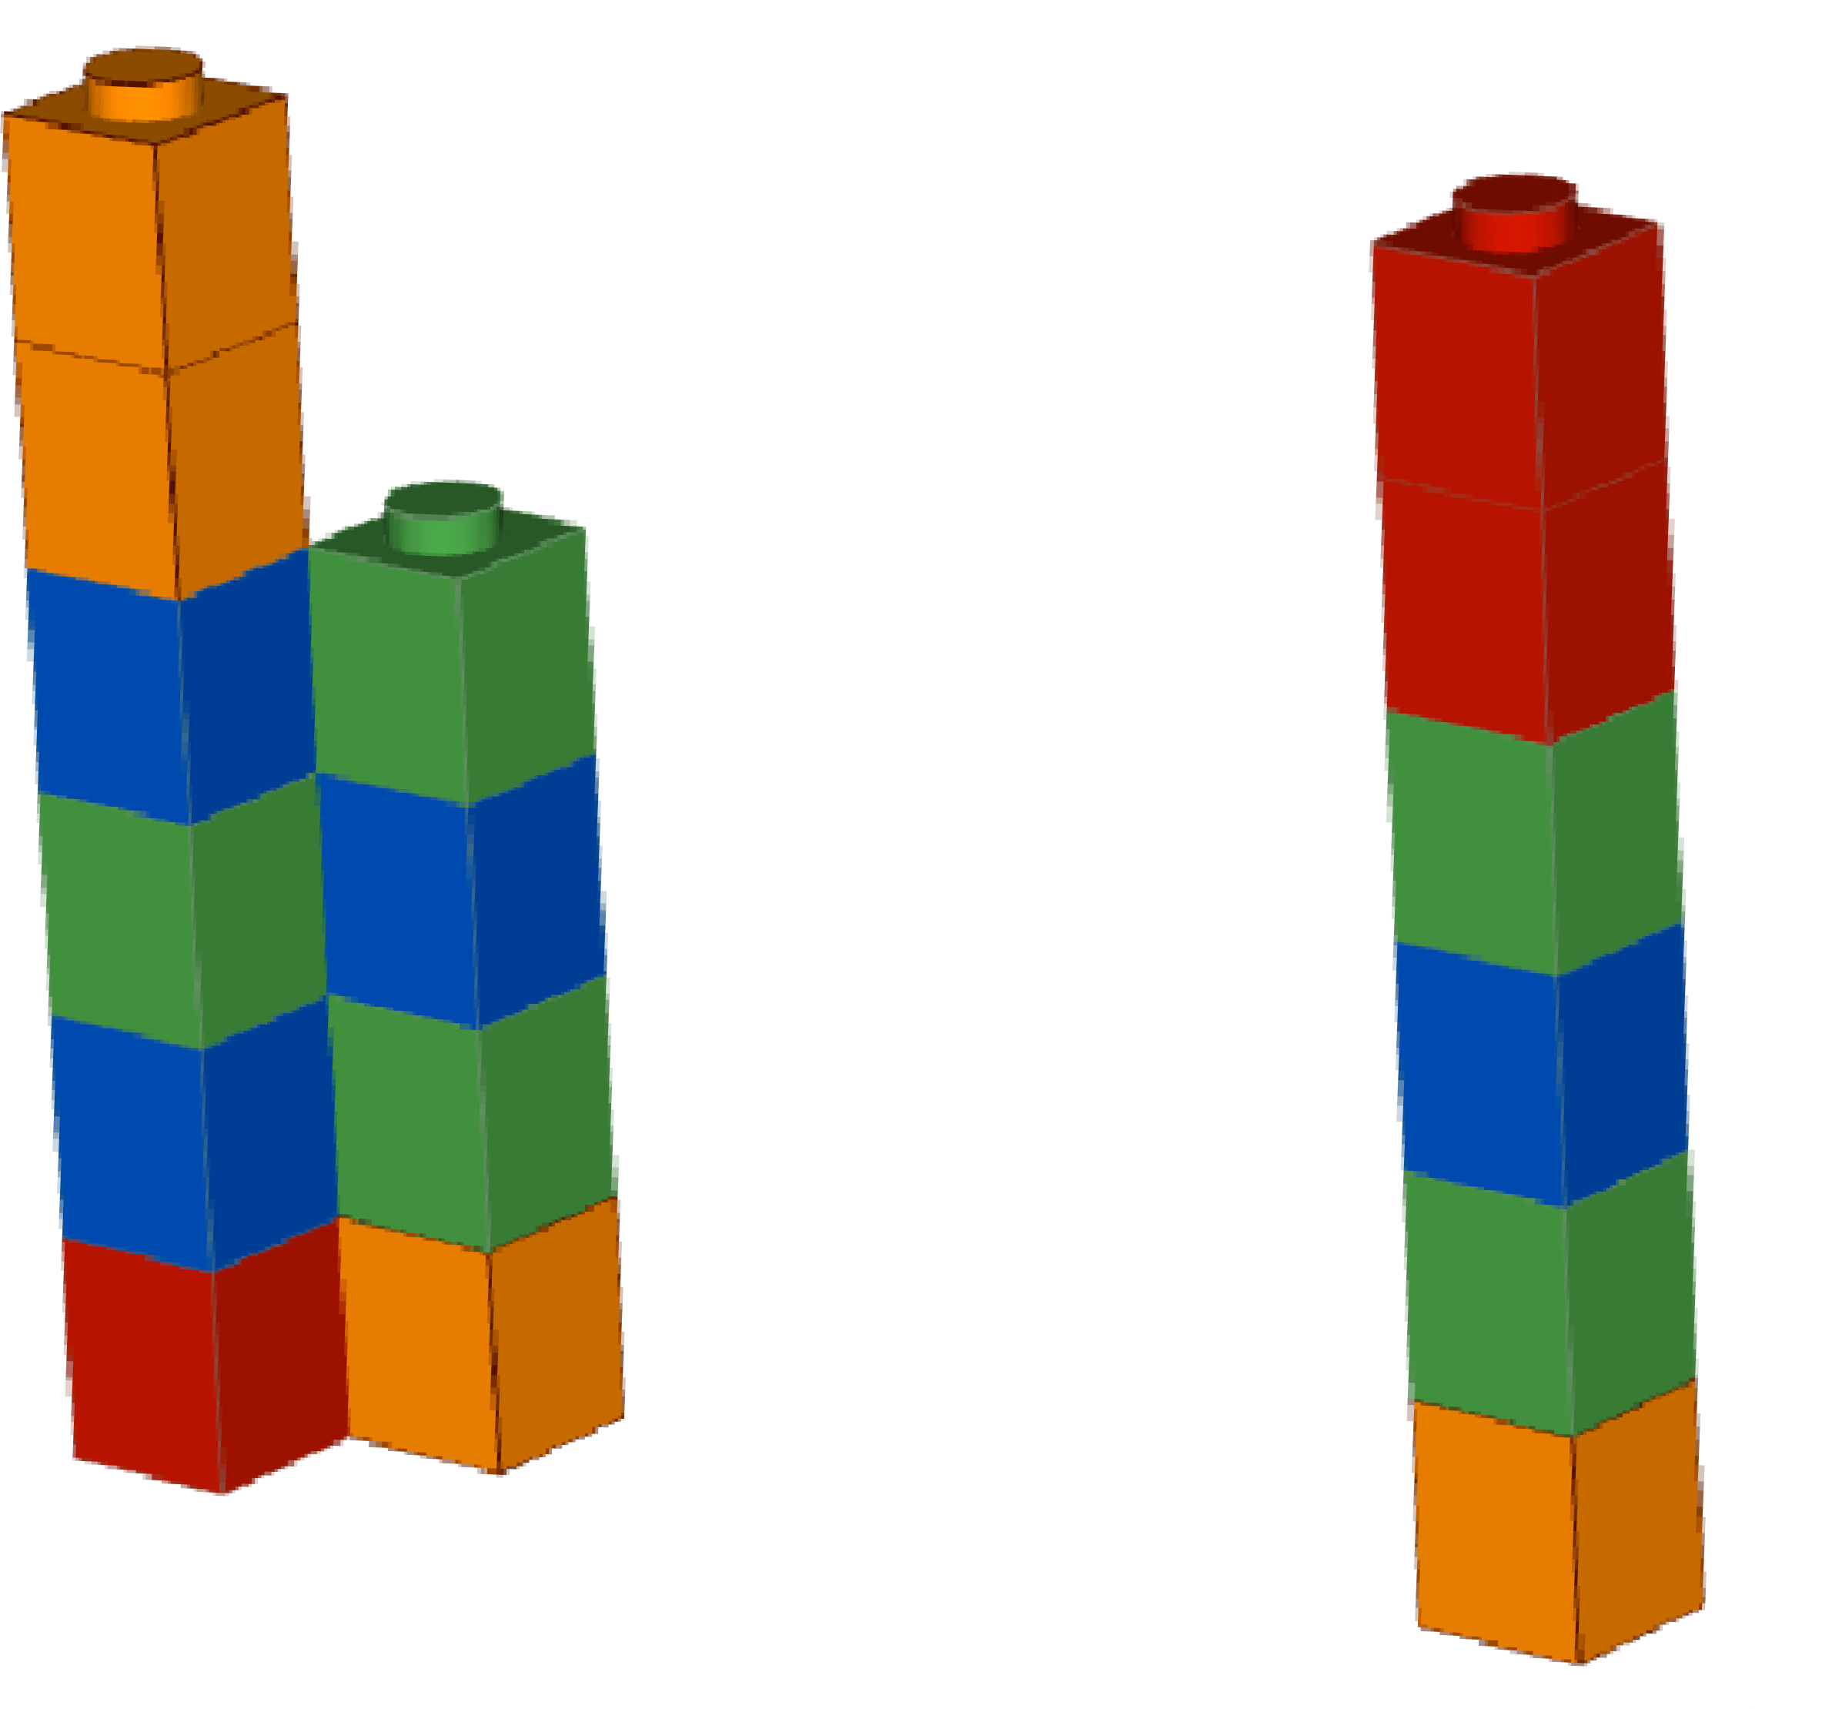
Illumina – Sequencing by synthesis
C C A T A G
G G T A T C
T A T C

Slide 26
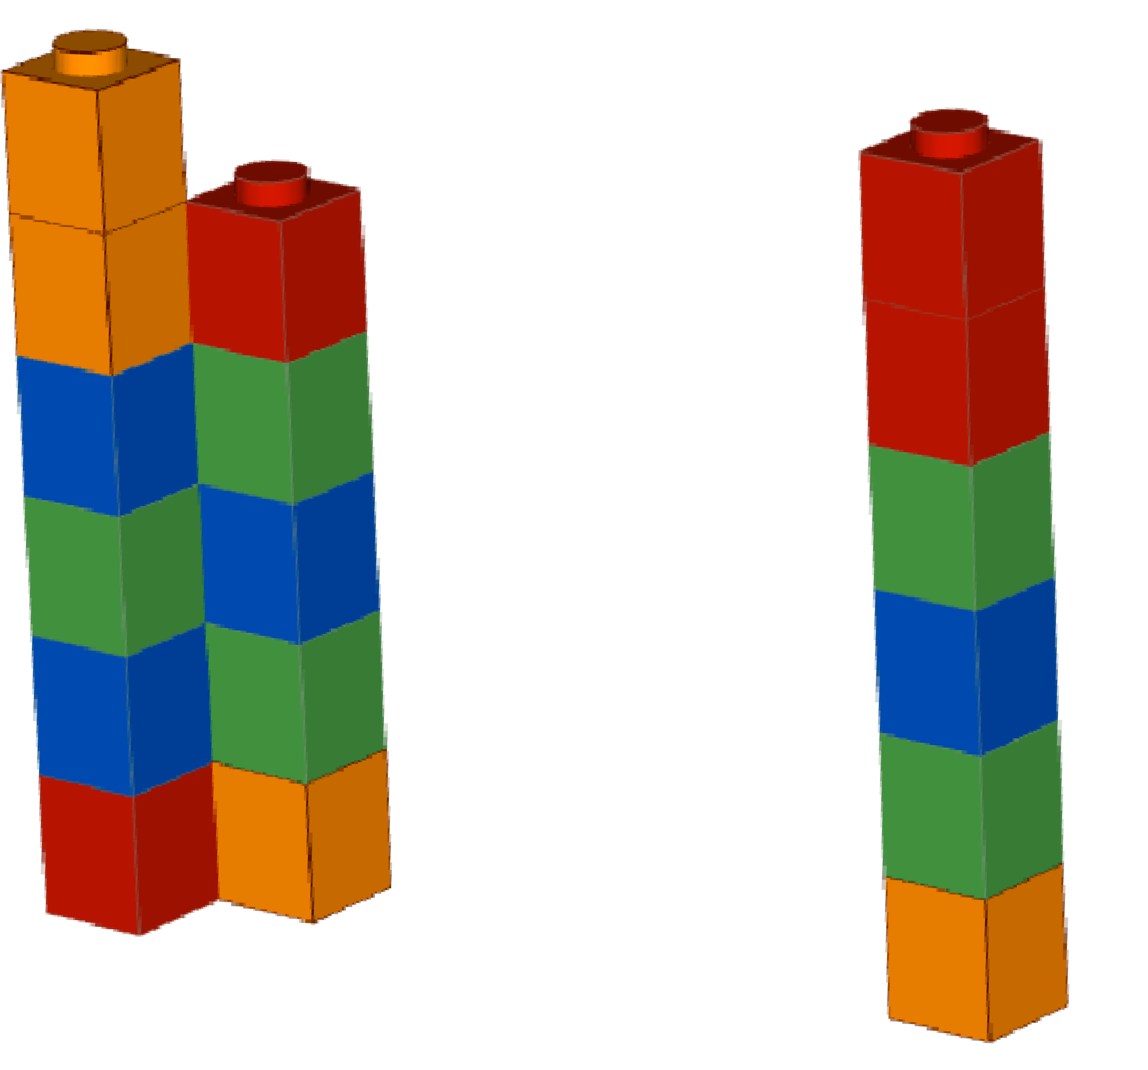
Illumina – Sequencing by synthesis
C C A T A G
G G T A T C
G T A T C

Slide 27
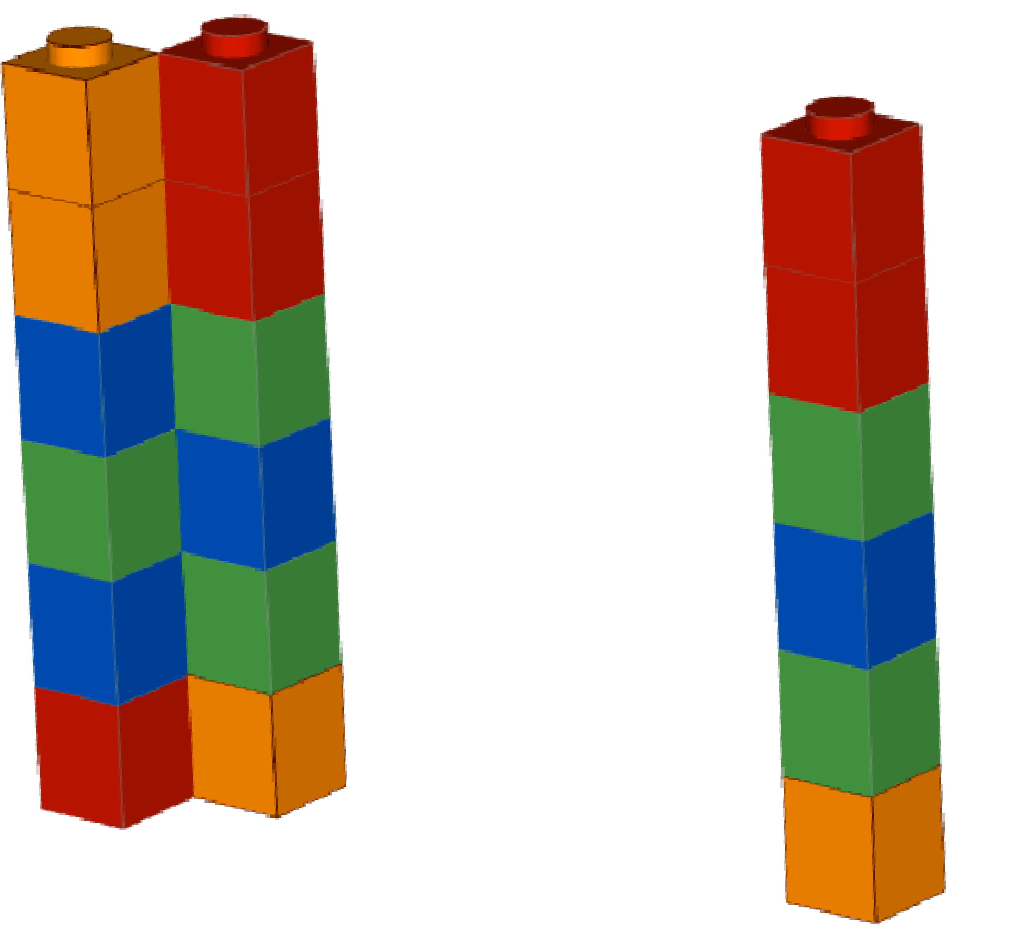
Illumina – Sequencing by synthesis
C C A T A G
G G
T A T C
G G T A T C

Slide 28
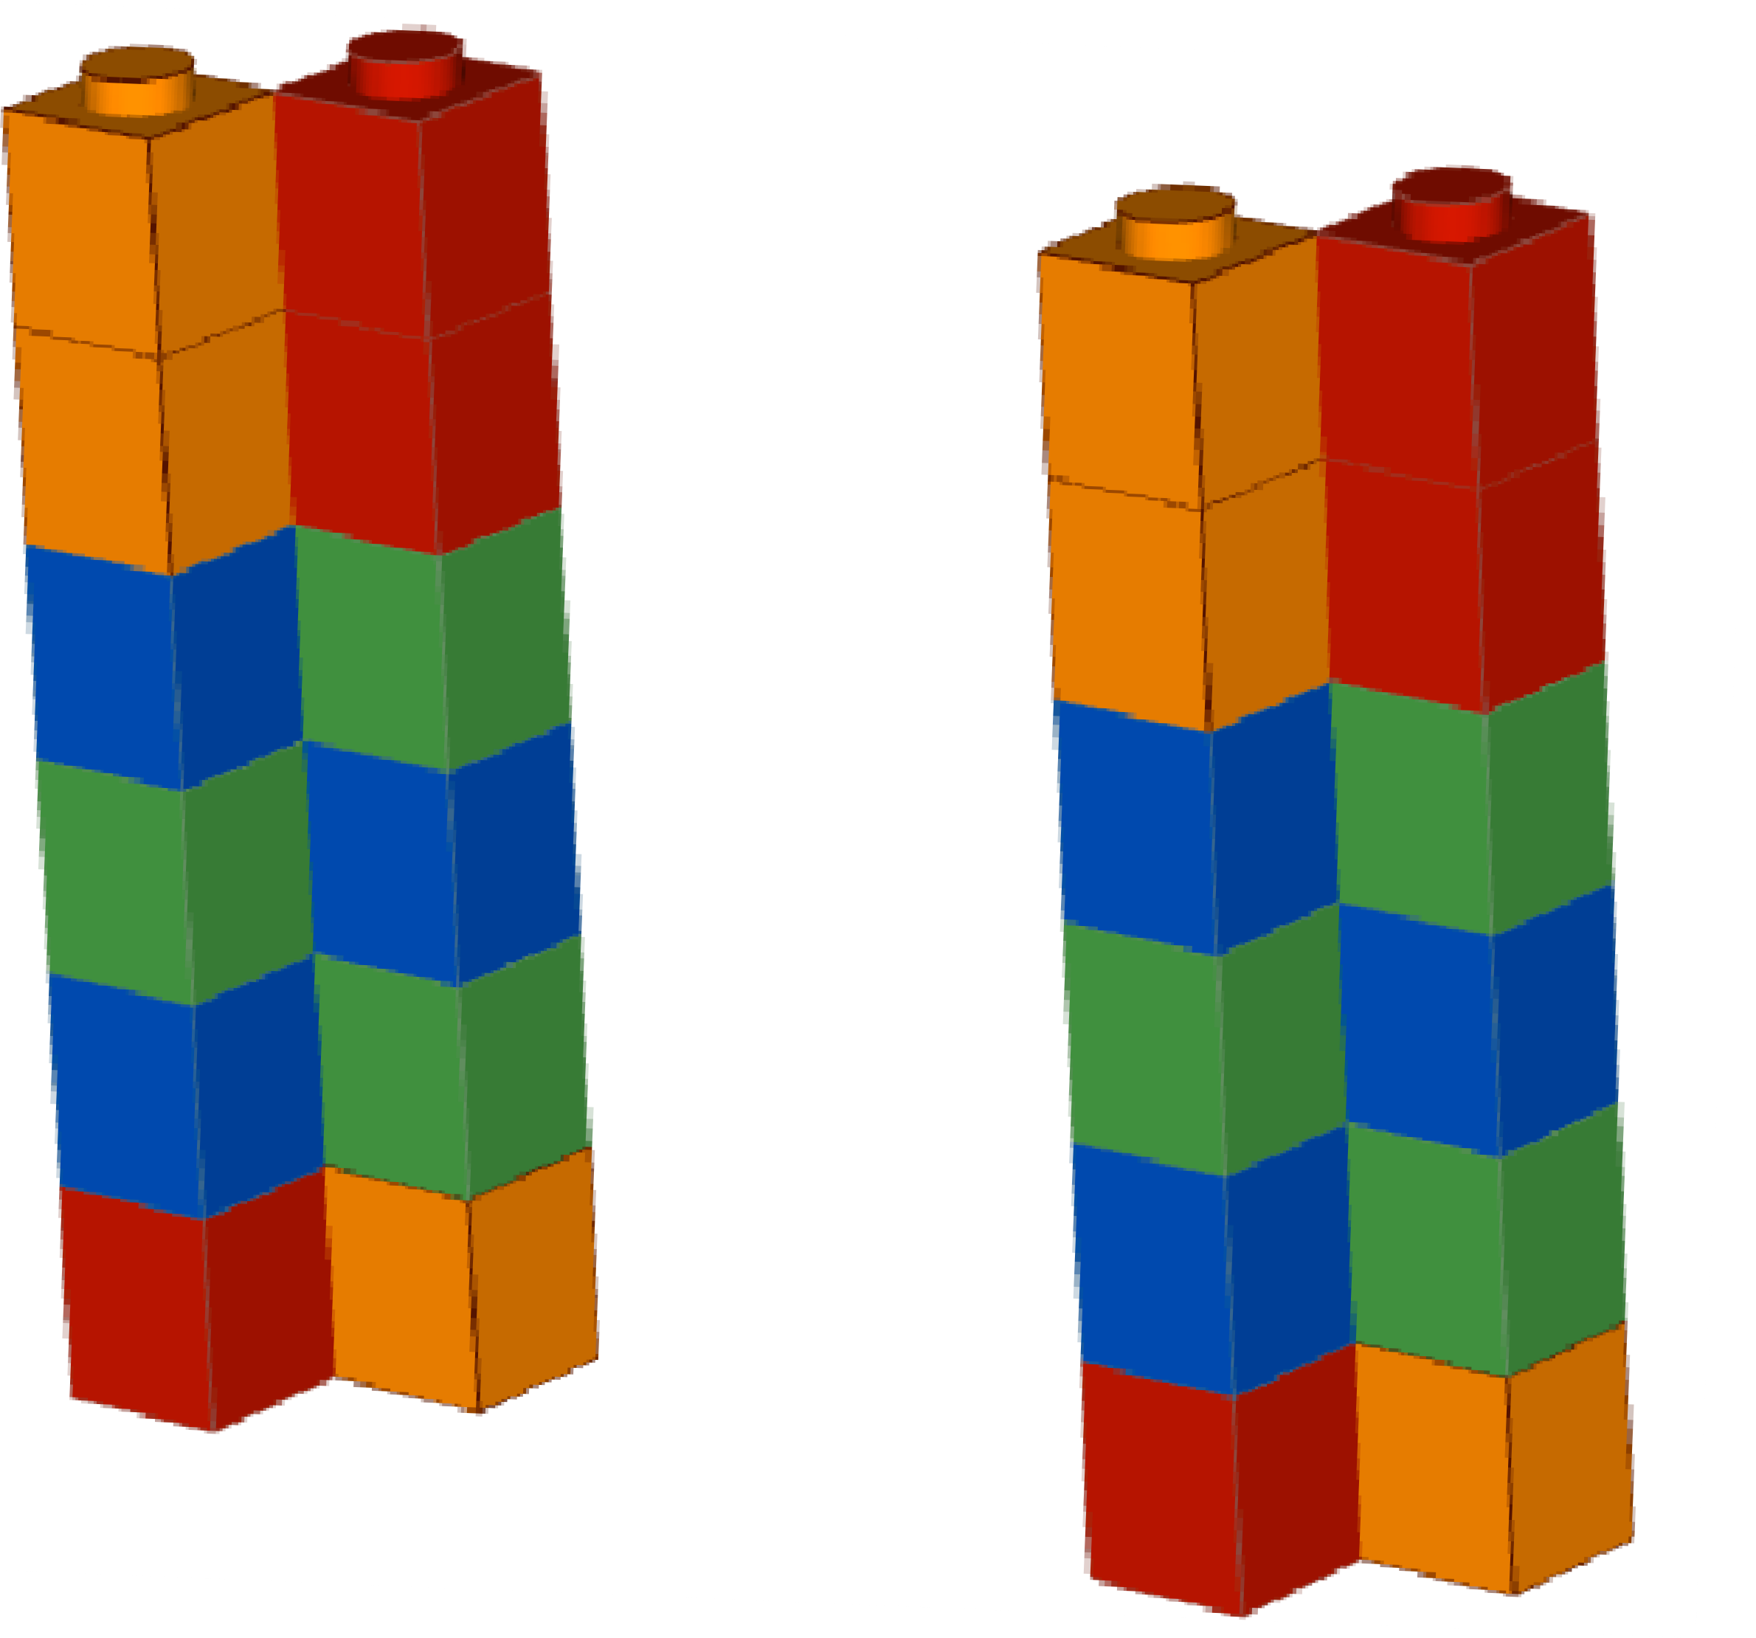
Illumina – Sequencing by synthesis
C C A T A G
G G
T A T C
C C A T A G
G G T A T C

Slide 29
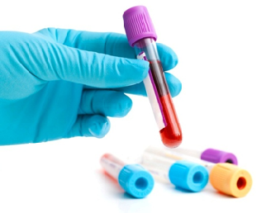
Input DNA CCATAGTATATCTCGGCTCTAGGCCCTCATTTTTT CCATAGTATATCTCGGCTCTAGGCCCTCATTTTTT
CCATAGTATATCTCGGCTCTAGGCCCTCATTTTTT CCATAGTATATCTCGGCTCTAGGCCCTCATTTTTT
Cut into snippets
CCATAGTA TATCTCGG CTCTAGGCCCTC
ATTTTTT TTTTTT TTTTTT
CCA TAGTATAT CTCGGCTCTAGGCCCTCA
CCATAGTAT ATCTCGGCTCTAG GCCCTCA
CCATAG TATATCT CGGCTCTAGGCCCT CATTTTTT
Deposit on slide
C C A T A G
More details: Accurate whole human genome sequencing using reversible terminator chemistry. Nature. 2008 Nov 6;456(7218):53-9

Slide 30
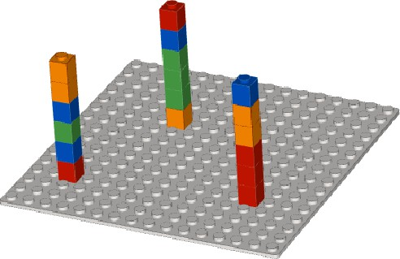
Illumina – Sequencing by synthesis
Template (billions of them!)
Slide (flowcell)

Slide 31
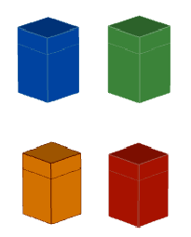



Illumina – Sequencing by synthesis
A
T
A
T
“Terminator” Pauses replication
Normal nucleotides
C
G
G
C
DNA polymerase

Slide 32
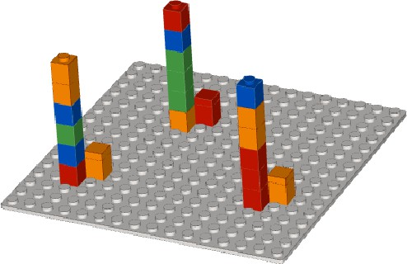
Illumina – Sequencing by synthesis

Slide 33
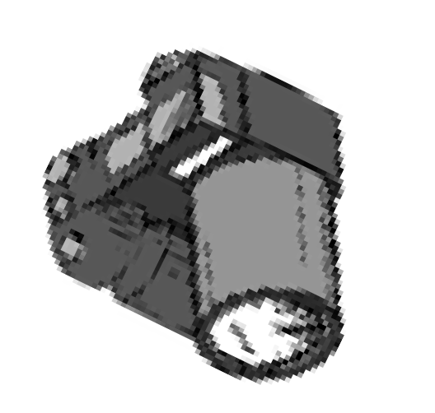
Illumina – Sequencing by synthesis
~~
~~
Fluorescence
~~

Slide 34
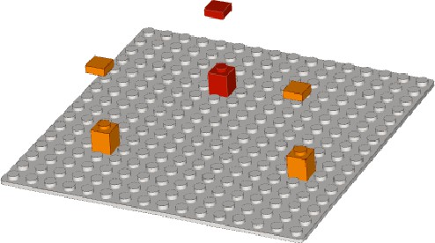


Illumina – Sequencing by synthesis
Remove terminators (Washing step)

Slide 35
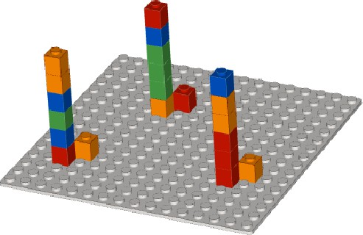
Illumina – Sequencing by synthesis
A
T
DNA polymerase
C
G

Slide 36
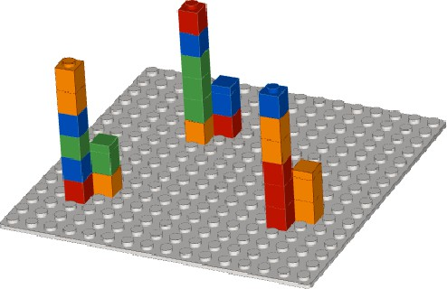
Illumina – Sequencing by synthesis

Slide 37
Illumina – Sequencing by synthesis

Slide 38
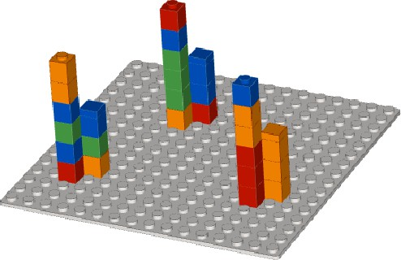
Illumina – Sequencing by synthesis

Slide 39
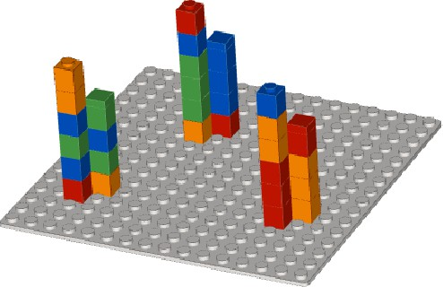
Illumina – Sequencing by synthesis

Slide 40
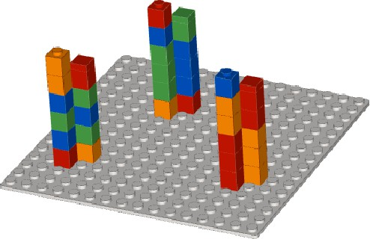
Illumina – Sequencing by synthesis

Slide 41
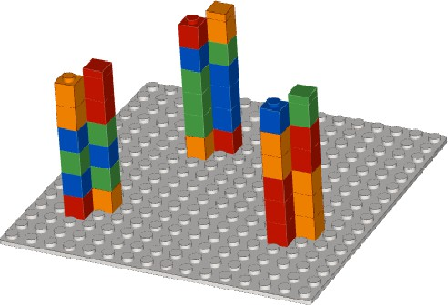
Illumina – Sequencing by synthesis

Slide 42
Illumina – Sequencing by synthesis
Cycle 1
Cycle 2
Cycle 3
Cycle 4
Cycle 5
Cycle 6

Slide 43


Illumina – Sequencing by synthesis
Cycle 1
Cycle 2 Cycle 3
Cycle 4
Cycle 5
Cycle 6
complement
complement
complement
complement
complement
complement
G
A
T
A
C
C
C
C
A
T
A
G

Slide 44
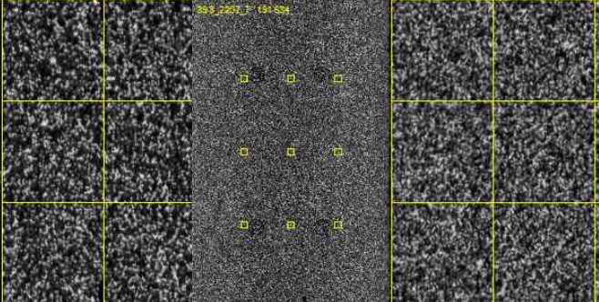
Illumina – Sequencing by synthesis
Actual Illumina HiSeq 3000 image
http://dnatech.genomecenter.ucdavis.edu/2015/05/07/ﬁrst-hiseq-3000-data-download/

Slide 45
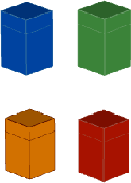
Illumina – Sequencing by synthesis
Billions of templates on a slide
Massively parallel: photograph captures all templates simultaneously Terminators are “speed bumps,” keeping reactions in sync

Slide 46
Illumina – Sequencing by synthesis

Slide 47
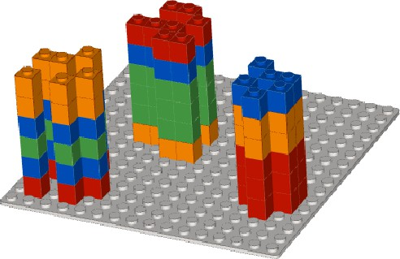
Illumina – Sequencing by synthesis
Cluster of clones

Slide 48
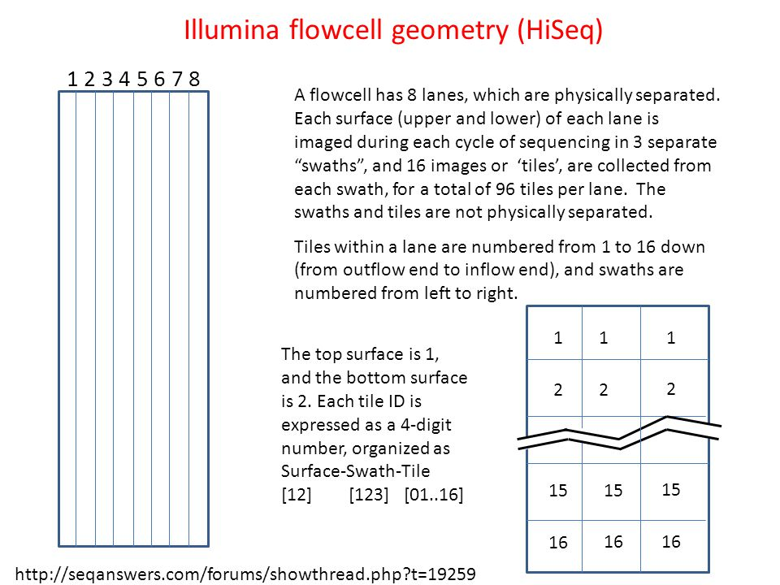
The Illumina Flowcell

Slide 49
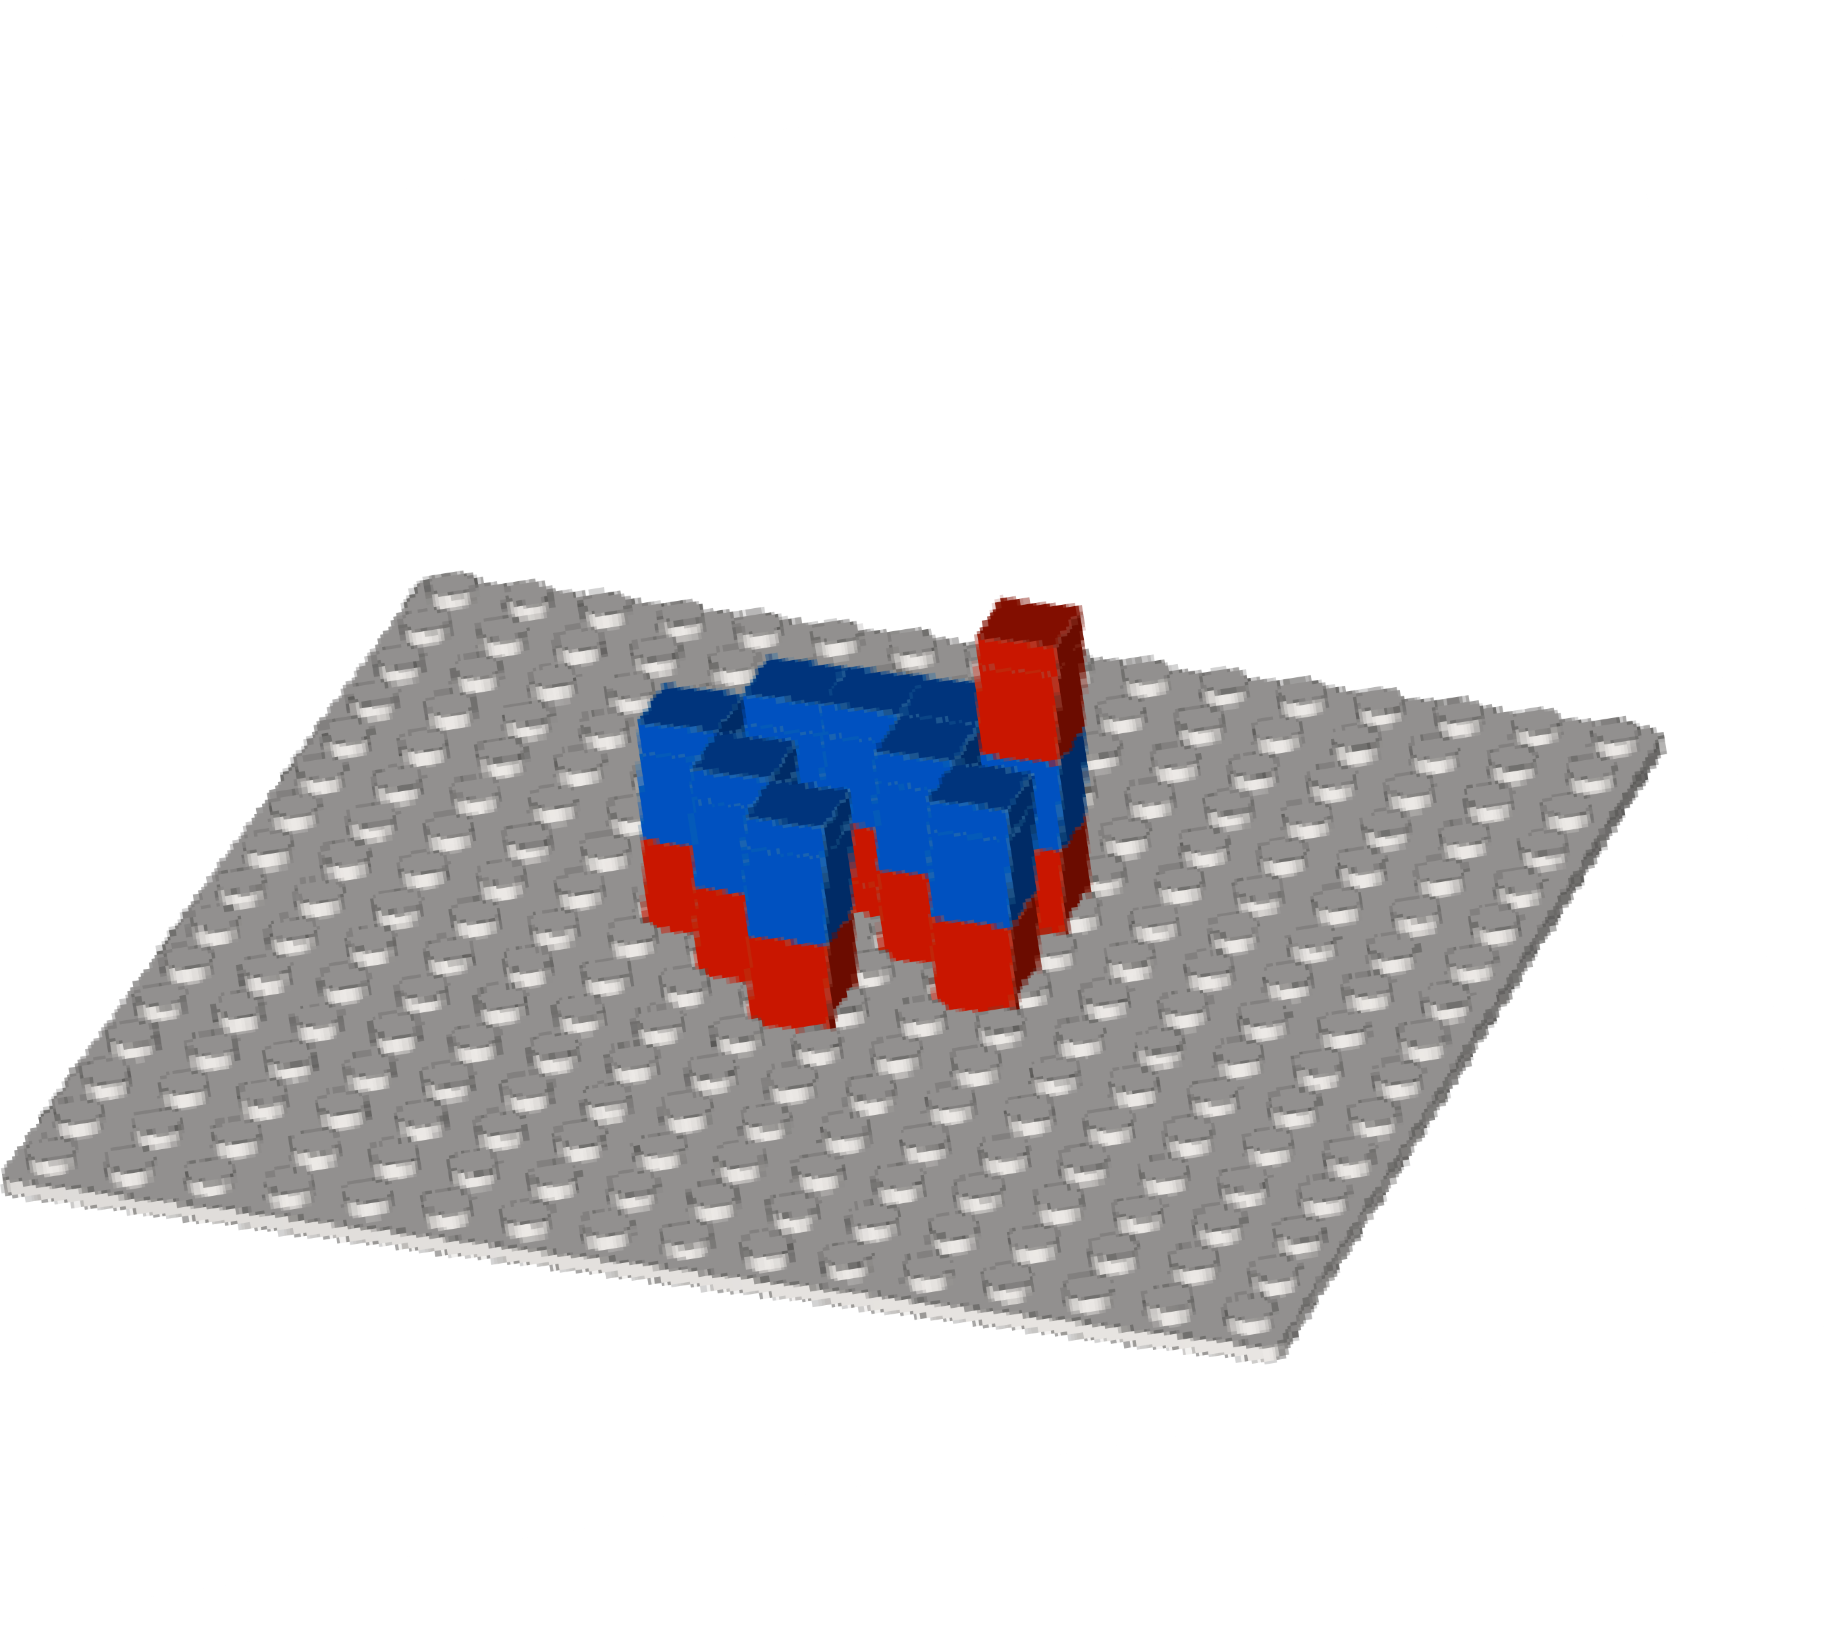
Illumina – Sequencing by synthesis
Ahead of schedule Unterminated

Slide 50
Illumina – Sequencing by synthesis

Slide 51

Illumina – Sequencing by synthesis

Slide 52
Illumina – Sequencing by synthesis
Q = -10 ∙ log10 p
Base quality
Probability that base call is incorrect
Q = 10 → 1 in 10 chance call is incorrect
Q = 20 → 1 in 100
Q = 30 → 1 in 1,000

Slide 53
Illumina – Sequencing by synthesis
Call: orange (C)
Estimate p, probability incorrect: non-orange light / total light
p = 3 green / 9 total = 1/3
Q = -10 log10 1/3 = 4.77

Slide 54
FASTQ format – Sequencing reads
Name
@ERR194146.1 HSQ1008:141:D0CC8ACXX:3:1308:20201:36071/1
Sequence
ACATCTGGTTCCTACTTCAGGGCCATAAAGCCTAAATAGCCCACACGTTCCCCTTAAAT
(ignore) +
Base qualities
?@@FFBFFDDHHBCEAFGEGIIDHGH@GDHHHGEHID@C?GGDG@FHIGGH@FHBEG:G

Slide 55

FASTQ format – Sequencing reads
Read 1 | Name
 | Sequence
 | (placeholder)
 | Base qualities
Read 2 | Name
 | Sequence
 | (placeholder)
 | Base qualities
Read 3 | Name
 | Sequence
 | (placeholder)
 | Base qualities
Read 4 | Name
 | Sequence
 | (placeholder)
 | Base qualities
Read 5 | Name
 | Sequence
 | (placeholder)
 | Base qualities

Slide 56
FASTQ format – Sequencing reads
Bases and qualities line up:
AGCTCTGGTGACCCATGGGCAGCTGCTAGGGA
|||||||||||||||||||||||||||||||| HHHHHHHHHHHHHHHGCGC5FEFFFGHHHHHH
Base quality is ASCII-encoded version of Q = -10 log10 p

Slide 57

FASTQ format – Sequencing reads

Slide 58


Genomics technology
2nd-generation DNA sequencing
Since ~2007
Sanger DNA sequencing
1977-1990s
3rd-generation & single-molecule DNA sequencing
Since ~2010
DNA Microarrays
Since mid-1990s

Slide 59
Third Generation Sequencing
Common components
Single molecule sequencing
Long-reads
Do not require amplification
Sequencing results in real-time
Differences
Different detection mechanisms
Library preparation chemistry
Flow cell configuration

Slide 60


Long read platforms comparison
PacBio
Pros: accuracy, read length, detect base modifications Cons: instrument cost
Oxford Nanopore
Pros: ultra long reads, cheap(er) instruments, direct RNA, detect base modifications
Cons: slightly lower accuracy

Slide 61

Long read sequencing
Pacific Biosciences sequencing
DNA templates are captured by DNA polymerase at the bottom of a tiny well
As the polymerase copies the template strand the incorporation events are recorded as flashes of light

Slide 62

PacBio sequencing
Pacific Biosciences HiFi sequencing
Clever molecular biology trick: add hairpins to either end of DNA molecule allowing sequencing to go around in a circle
Perform multiple passes to create a consensus
read with ~99.9% accuracy

Slide 63

PacBio sequencing
CLR: - It sequences the DNA strand once.
- Reads are long (>30,000bp) but fairly error prone (10-15% errors) - Using this approach as single molecule sequencing has low signal- to-noise ratio
CCS:
- It sequences the strand multiple times.
- Reads are shorter (~10,000bp) but of high quality (0.1% errors)

Slide 64

PacBio sequencing

Slide 65

Pacific Biosciences - PacBio

Slide 66

Nanopore sequencing
Miniaturized sequencing device that connects to a standard laptop

Slide 67

Nanopore sequencing
Oxford Nanopore Sequencing
DNA is pushed through a nanopore (a transmembrane pore protein) using a motor protein
The system senses electrical signal, and every nucleotide has a different electric current
Machine learning is used to decode “squiggle” into a predicted read sequence
Reads can be very long (>100kb), ~99% accurate

Slide 68

Nanopore sequencing
Oxford Nanopore Sequencing
DNA is pushed through a nanopore (a transmembrane pore protein) using a motor protein
The system senses electrical signal, and every nucleotide has a different electric current
Machine learning is used to decode “squiggle” into a predicted read sequence
Reads can be very long (>100kb), ~99% accurate
Figure from Goodwin et al.

Slide 69
Oxford Nanopore - ONT

Slide 70

Oxford Nanopore - ONT
Duplex sequencing – Passing both DNA strands through the pore -> Double accuracy

Slide 71

Oxford Nanopore - ONT
Adaptive sequencing – Depleting or enriching sequences on the fly

Slide 72

Oxford Nanopore - ONT
Nanopore raw current files – Pod5
Fast5/Pod5 file format
Basecalling
Fastq/Bam format

Slide 73

First Generation Sequencing

Slide 74
Second Generation Sequencing

Slide 75
Third Generation Sequencing

Slide 76

Review Sequencing Technologies

Slide 77
Assignment 1
We will compare the characteristics and SNP calls for three sequencing technologies:
Illumina
PacBio
Nanopore
The benchmarking will be done using the well-characterized HG002

Slide 78
Assignment 1
Raw
Fastq
Filtered
Fastq
BAM
VCF

Slide 79
Assignment 1
Raw
Fastq
Filtered
Fastq
BAM
VCF
Fastq
QC

Slide 80

Quality check
Per base sequence quality

Slide 81

Quality check
Per tile sequence quality

Slide 82

Quality check
Per sequence quality scores

Slide 83

Quality check
Per base sequence content

Slide 84

Quality check
Per base sequence content

Slide 85

Quality check
Per sequence GC content

Slide 86

Quality check
Per base N content

Slide 87

Quality check
Sequence Length Distribution

Slide 88

Quality check
Sequence Duplication Levels

Slide 89

Quality check
Overrepresented sequences

Slide 90

Quality check
Adapter Content

Slide 91
Assignment 1
Raw
Fastq
Filtered
Fastq
BAM
VCF
Fastq
QC
Read mapping

Slide 92




Mapping and variant calling
BWA
SAMtools
BCFtools

Slide 93

The SAM/BAM format

Slide 94

The SAM/BAM format

Slide 95

The SAM/BAM format

Slide 96
Mapping – Read Groups
Read groups – Provide technical information about flowcell and multiplexing of illumina reads
@D00360:18:H8VC6ADXX:1:2113:12103:41717
Instrument
name
Run ID
Flowcell
ID
ID = {FLOWCELL_BARCODE}.{LANE}
PU = {FLOWCELL_BARCODE}.{LANE}.{SAMPLE_BARCODE}
bwa mem -R "@RG\tID:H8VC6ADXX.1\tH8VC6ADXX.1.sample1\tPL:HiSeq\tSM:Sample" reference fwd rev

Slide 97

Marking duplicates
Software:
- Picard
- sambamba
Software:
- Picard
- sambamba

Slide 98
Assignment 1
Raw
Fastq
Filtered
Fastq
BAM
VCF
Fastq
QC
Read mapping
Variant Calling

Slide 99
Assignment 1
Raw
Fastq
Filtered
Fastq
BAM
VCF
Fastq
QC
Read mapping
Variant Calling
Trimmomatic
FiltLong
BWA
minimap2
Bcftools GATK
FreeBayes
Medaka
Clair3
Longshot

Slide 100
Assignment 1
Final output
Sample VCF
Benchmark VCF
#CHROM | POS | ID | REF | ALT | QUAL | FILTER | INFO | FORMAT | SAMPLE
chr1 | 1 | . | T | G | 60 | PASS | … | GT | 1/1
chr1 | 2 | . | T | . | 60 | PASS | … | GT | 0/0
chr1 | 3 | . | G | C | 60 | PASS | … | GT | 1/1
chr1 | 4 | . | A | G | 60 | FAIL | … | GT | 1/1
chr1 | 5 | . | C | A | 60 | PASS | … | GT | 1/1
#CHROM | POS | ID | REF | ALT | QUAL | FILTER | INFO | FORMAT | SAMPLE
chr1 | 1 | . | T | G | 60 | PASS | … | GT | 1/1
chr1 | 2 | . | T | A | 60 | PASS | … | GT | 1/1
chr1 | 3 | . | G | C | 60 | PASS | … | GT | 0/1
chr1 | 4 | . | A | G | 60 | PASS | … | GT | 1/1
chr1 | 5 | . | C | T | 60 | PASS | … | GT | 1/1

Slide 101
Assignment 1
Final output
True Positive
Sample VCF
Benchmark VCF
#CHROM | POS | ID | REF | ALT | QUAL | FILTER | INFO | FORMAT | SAMPLE
chr1 | 1 | . | T | G | 60 | PASS | … | GT | 1/1
chr1 | 2 | . | T | . | 60 | PASS | … | GT | 0/0
chr1 | 3 | . | G | C | 60 | PASS | … | GT | 1/1
chr1 | 4 | . | A | G | 60 | FAIL | … | GT | 1/1
chr1 | 5 | . | C | A | 60 | PASS | … | GT | 1/1
chr1 | 6 | . | T | C | 60 | PASS | … | GT | 1/1
chr1 | 7 | . | T | . | 60 | PASS | … | GT | 0/0
#CHROM | POS | ID | REF | ALT | QUAL | FILTER | INFO | FORMAT | SAMPLE
chr1 | 1 | . | T | G | 60 | PASS | … | GT | 1/1
chr1 | 2 | . | T | A | 60 | PASS | … | GT | 1/1
chr1 | 3 | . | G | C | 60 | PASS | … | GT | 0/1
chr1 | 4 | . | A | G | 60 | PASS | … | GT | 1/1
chr1 | 5 | . | C | T | 60 | PASS | … | GT | 1/1
chr1 | 6 | . | T | . | 60 | PASS | … | GT | 0/0
chr1 | 7 | . | T | . | 60 | PASS | … | GT | 0/0
True Negative

Slide 102
Assignment 1
Final output
True Positive
False Negative
Sample VCF
Benchmark VCF
#CHROM | POS | ID | REF | ALT | QUAL | FILTER | INFO | FORMAT | SAMPLE
chr1 | 1 | . | T | G | 60 | PASS | … | GT | 1/1
chr1 | 2 | . | T | . | 60 | PASS | … | GT | 0/0
chr1 | 3 | . | G | C | 60 | PASS | … | GT | 1/1
chr1 | 4 | . | A | G | 60 | FAIL | … | GT | 1/1
chr1 | 5 | . | C | A | 60 | PASS | … | GT | 1/1
chr1 | 6 | . | T | C | 60 | PASS | … | GT | 1/1
chr1 | 7 | . | T | . | 60 | PASS | … | GT | 0/0
#CHROM | POS | ID | REF | ALT | QUAL | FILTER | INFO | FORMAT | SAMPLE
chr1 | 1 | . | T | G | 60 | PASS | … | GT | 1/1
chr1 | 2 | . | T | A | 60 | PASS | … | GT | 1/1
chr1 | 3 | . | G | C | 60 | PASS | … | GT | 0/1
chr1 | 4 | . | A | G | 60 | PASS | … | GT | 1/1
chr1 | 5 | . | C | T | 60 | PASS | … | GT | 1/1
chr1 | 6 | . | T | . | 60 | PASS | … | GT | 0/0
chr1 | 7 | . | T | . | 60 | PASS | … | GT | 0/0
True Negative
False Positive

Slide 103

Assignment 1

Slide 104


Assignment 1
Benchmarking
F1 score

Slide 105
Assignment 1
True Positive Rate (TPR)
Specificity = 1 - FPR

Slide 106
Assignment 1
BAM
VCF
VCF/Bed
Illumina
BWA mem
Bcftools GATK
FreeBayes
DeepVariant
Raw
Fastq
VCF benchmarking
ONT
PacBio
minimap2

Slide 107
Assignment 1
##fileformat=VCFv4.3
##contig=<ID=chr1,length=249250621> ##INFO=<ID=DP,Number=1,Type=Integer,Description="Read Depth"> ##FORMAT=<ID=GT,Number=1,Type=String,Description="Genotype">
VCF
#CHROM | POS | ID | REF | ALT | QUAL | FILTER | INFO | FORMAT | sample
chr1 | 100 | rs123 | A | G | 30 | PASS | … | GT | 0/1
chr1 | 200 | rs456 | C | T | 40 | PASS | … | GT | 1/1
chr1 | 300 | . | G | A | 20 | PASS | … | GT | 1/1
chr2 | 150 | rs789 | T | C | 50 | PASS | … | GT | 1/1
chr1 | 99 | 100 | rs123
chr1 | 199 | 200 | rs456
chr1 | 299 | 300 | .
BED

Slide 108

Assignment 1

Slide 109
Assignment 1
1 | 2 | 3 | 4 | 5 | 6 | 7 | 8 | 9 | 10 | 11 | 12 | 13 | 14 | 15 | 16 | 17 | 18 | 19 | 20
T | C | C | A | G | C | C | C | T | C | A | G | C | G | T | C | A | T | G | C
T | C | C | T | G | C | A | C | G | C | A | G | C | G | T | C | A | T | C | C
Benchmark
Sample
False Positives

Slide 110
Assignment 1
1 | 2 | 3 | 4 | 5 | 6 | 7 | 8 | 9 | 10 | 11 | 12 | 13 | 14 | 15 | 16 | 17 | 18 | 19 | 20
T | C | C | A | G | C | C | C | T | C | A | G | C | G | T | C | A | T | G | C
T | C | C | T | G | C | A | C | G | C | A | G | C | G | T | C | A | T | C | C
Benchmark
Sample
1. Get list of FP into bed file
Chr 3 4
Chr 6 7
Chr 8 9
Chr 18 19

Slide 111
Assignment 1
1 | 2 | 3 | 4 | 5 | 6 | 7 | 8 | 9 | 10 | 11 | 12 | 13 | 14 | 15 | 16 | 17 | 18 | 19 | 20
T | C | C | A | G | C | C | C | T | C | A | G | C | G | T | C | A | T | G | C
T | C | C | T | G | C | A | C | G | C | A | G | C | G | T | C | A | T | C | C
Benchmark
Sample
1. Get list of FP into bed file
2. Make genomic windows for your chromosome
Chr 3 4
Chr 6 7
Chr 8 9
Chr 18 19
Chr 0 10
Chr 10 20
Chr 20

Slide 112
Assignment 1
1 | 2 | 3 | 4 | 5 | 6 | 7 | 8 | 9 | 10 | 11 | 12 | 13 | 14 | 15 | 16 | 17 | 18 | 19 | 20
T | C | C | A | G | C | C | C | T | C | A | G | C | G | T | C | A | T | G | C
T | C | C | T | G | C | A | C | G | C | A | G | C | G | T | C | A | T | C | C
Benchmark
Sample
FP = 3
FP = 1
1. Get list of FP into bed file
2. Make genomic windows for your chromosome
3. Count number of FP in windows
Chr 3 4
Chr 6 7
Chr 8 9
Chr 18 19
Chr 0 10
Chr 10 20
Chr 20

Slide 113
Assignment 1
1 | 2 | 3 | 4 | 5 | 6 | 7 | 8 | 9 | 10 | 11 | 12 | 13 | 14 | 15 | 16 | 17 | 18 | 19 | 20
T | C | C | A | G | C | C | C | T | C | A | G | C | G | T | C | A | T | G | C
T | C | C | T | G | C | A | C | G | C | A | G | C | G | T | C | A | T | C | C
Benchmark
Sample
3
FP
2
1
Position

Slide 114
Assignment 1
1 | 2 | 3 | 4 | 5 | 6 | 7 | 8 | 9 | 10 | 11 | 12 | 13 | 14 | 15 | 16 | 17 | 18 | 19 | 20
T | C | C | A | G | C | C | C | T | C | A | G | C | G | T | C | A | T | G | C
T | C | C | T | G | C | A | C | G | C | A | G | C | G | T | C | A | T | C | C
Benchmark
Sample
FP = 3
FP = 1
3
FP
2
1
Position

